Slide 1
“Useful” Physiopathology of the venular telangiectasic system
Ermini Stefano
www.chiva.it

Slide 2
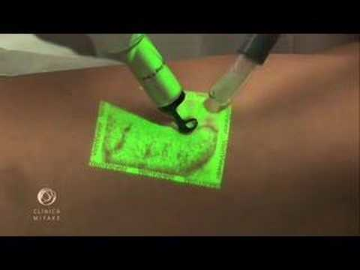
New investigation methods and new thecnologist deveices
have not improved results of teleangiectasia treatments
Phisiopathology is unknow
Pubmed:
Cellulite + teleangiectasias = no match found
Telangiectasia + color doppler = no match found
Telangiectasia + duplex scan = 2 match ( 1993)

Slide 3
Unsolved problems
Different kinds of teleangiectasias ( anatomy of the hair of the tree, hair up, hair down )
Location in the lower leg
Interactions with the reticolar veins ( filling or draining )
Role of the perforator veins
Relations with the saphenous system

Slide 4
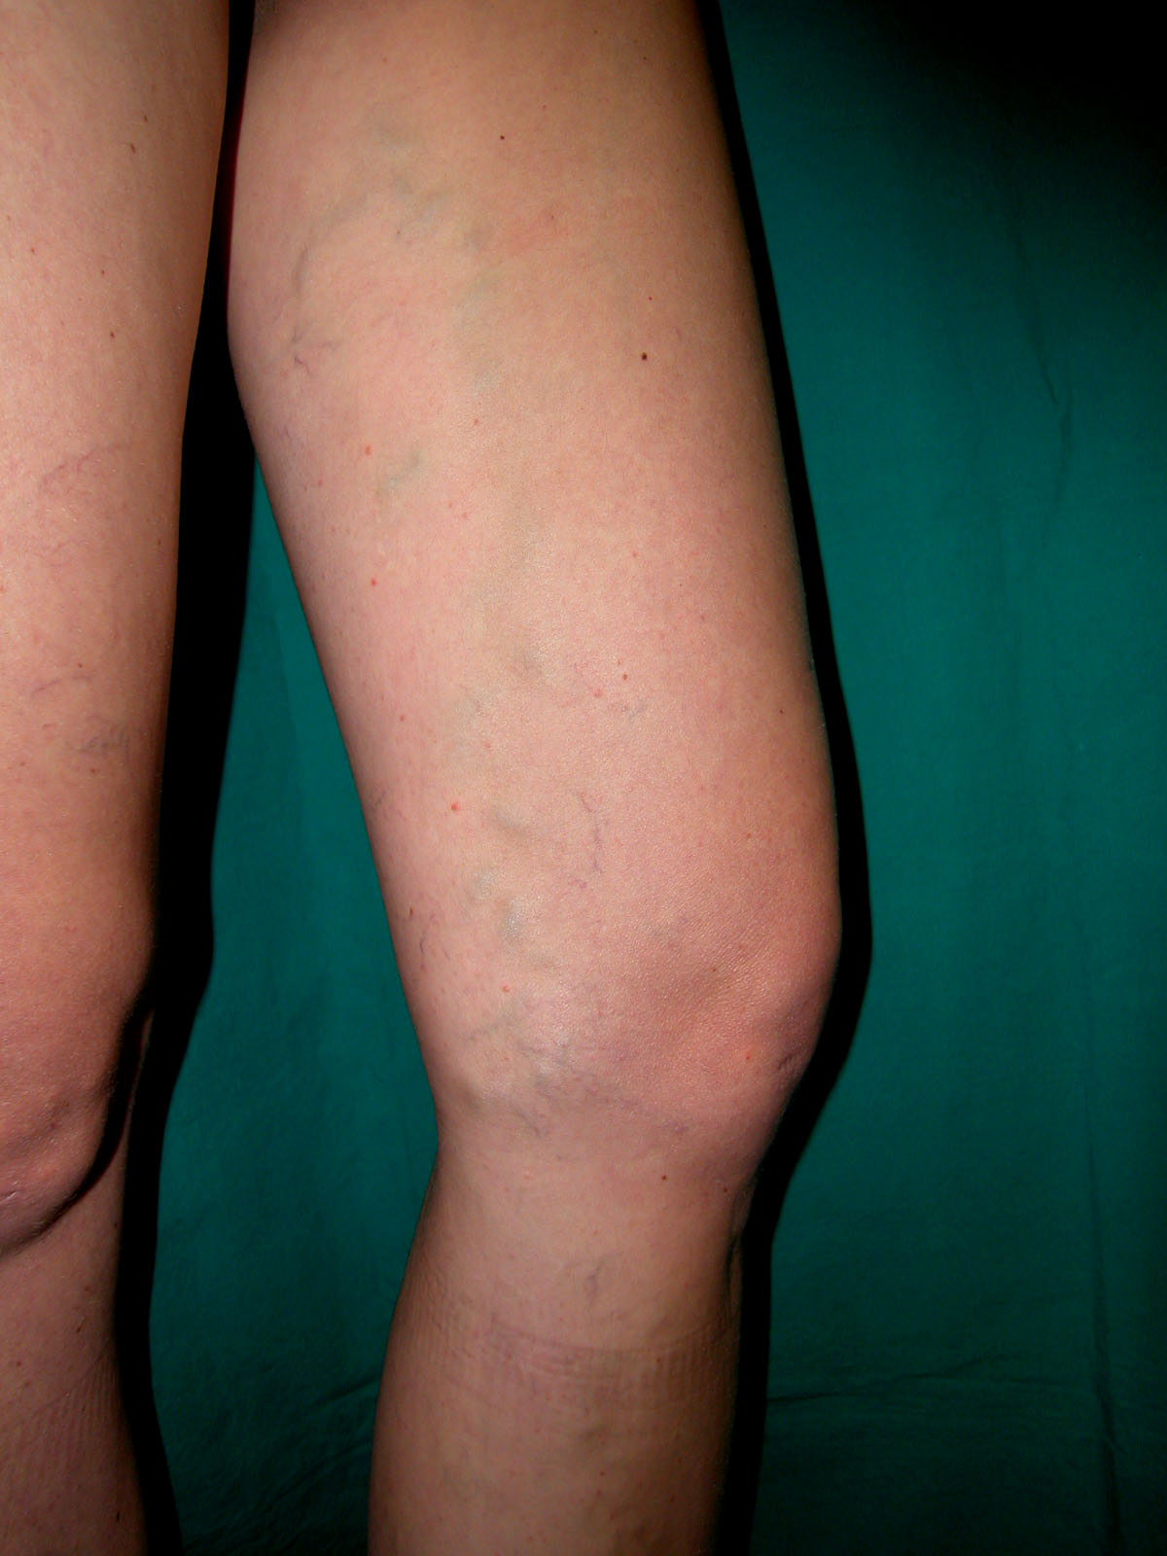
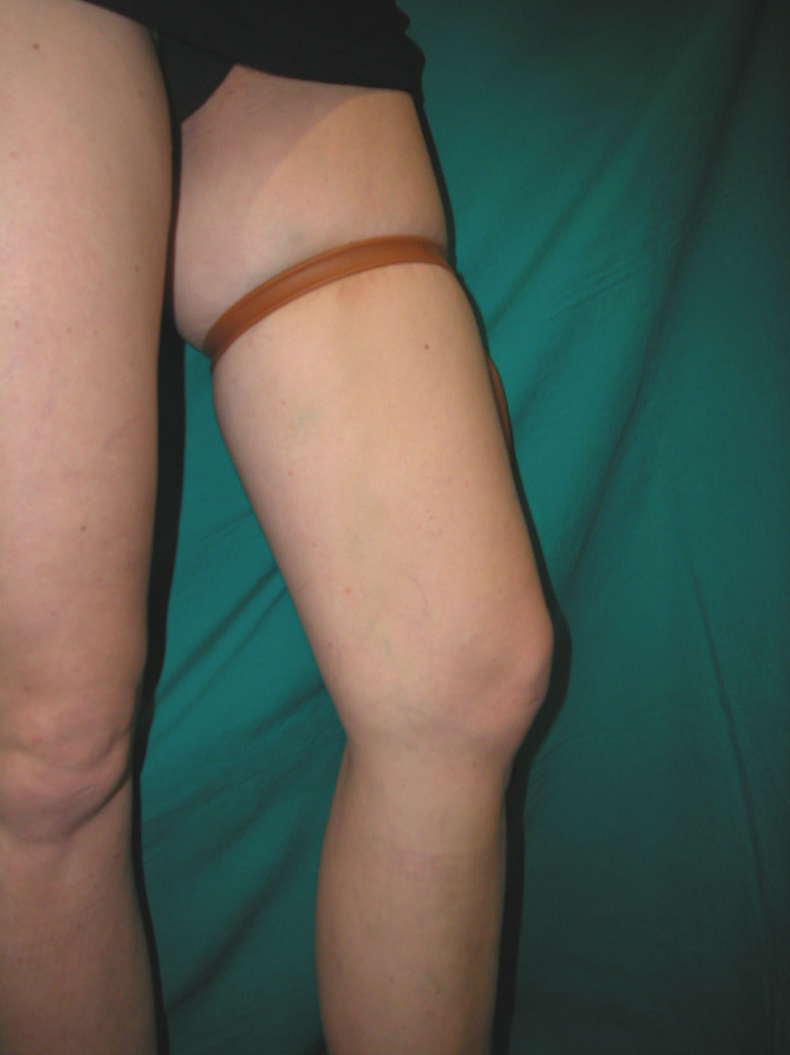
Perthes Test
Reduction of the filling gradient (Tourniquet)
+
Improvement of the draining gradient ( muscle pomp activity)
=
Collapse of the visible varices

Slide 5
Every Telangiectasic tree have a filling and a draining pressure gradient
Like in a varicose sistem, I can resolve the telangiectasia by improving the drainage and reducing the filling gradient.
First , I have to recognize the filling and the draining reticular vein.

Slide 6
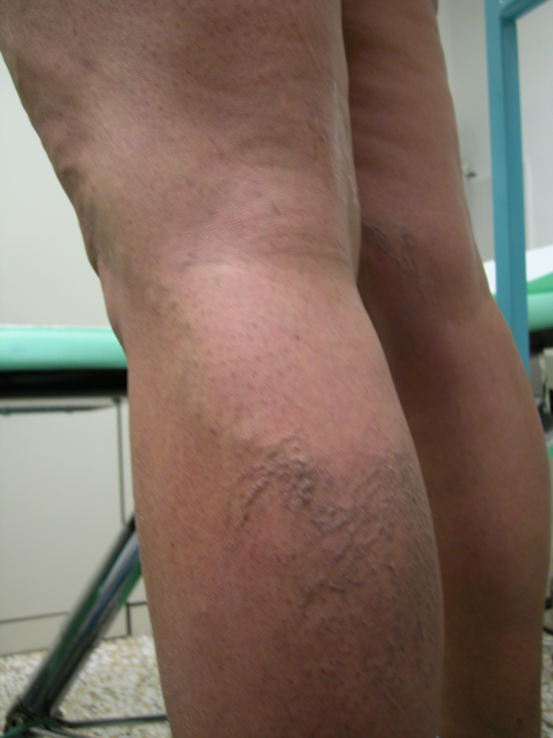
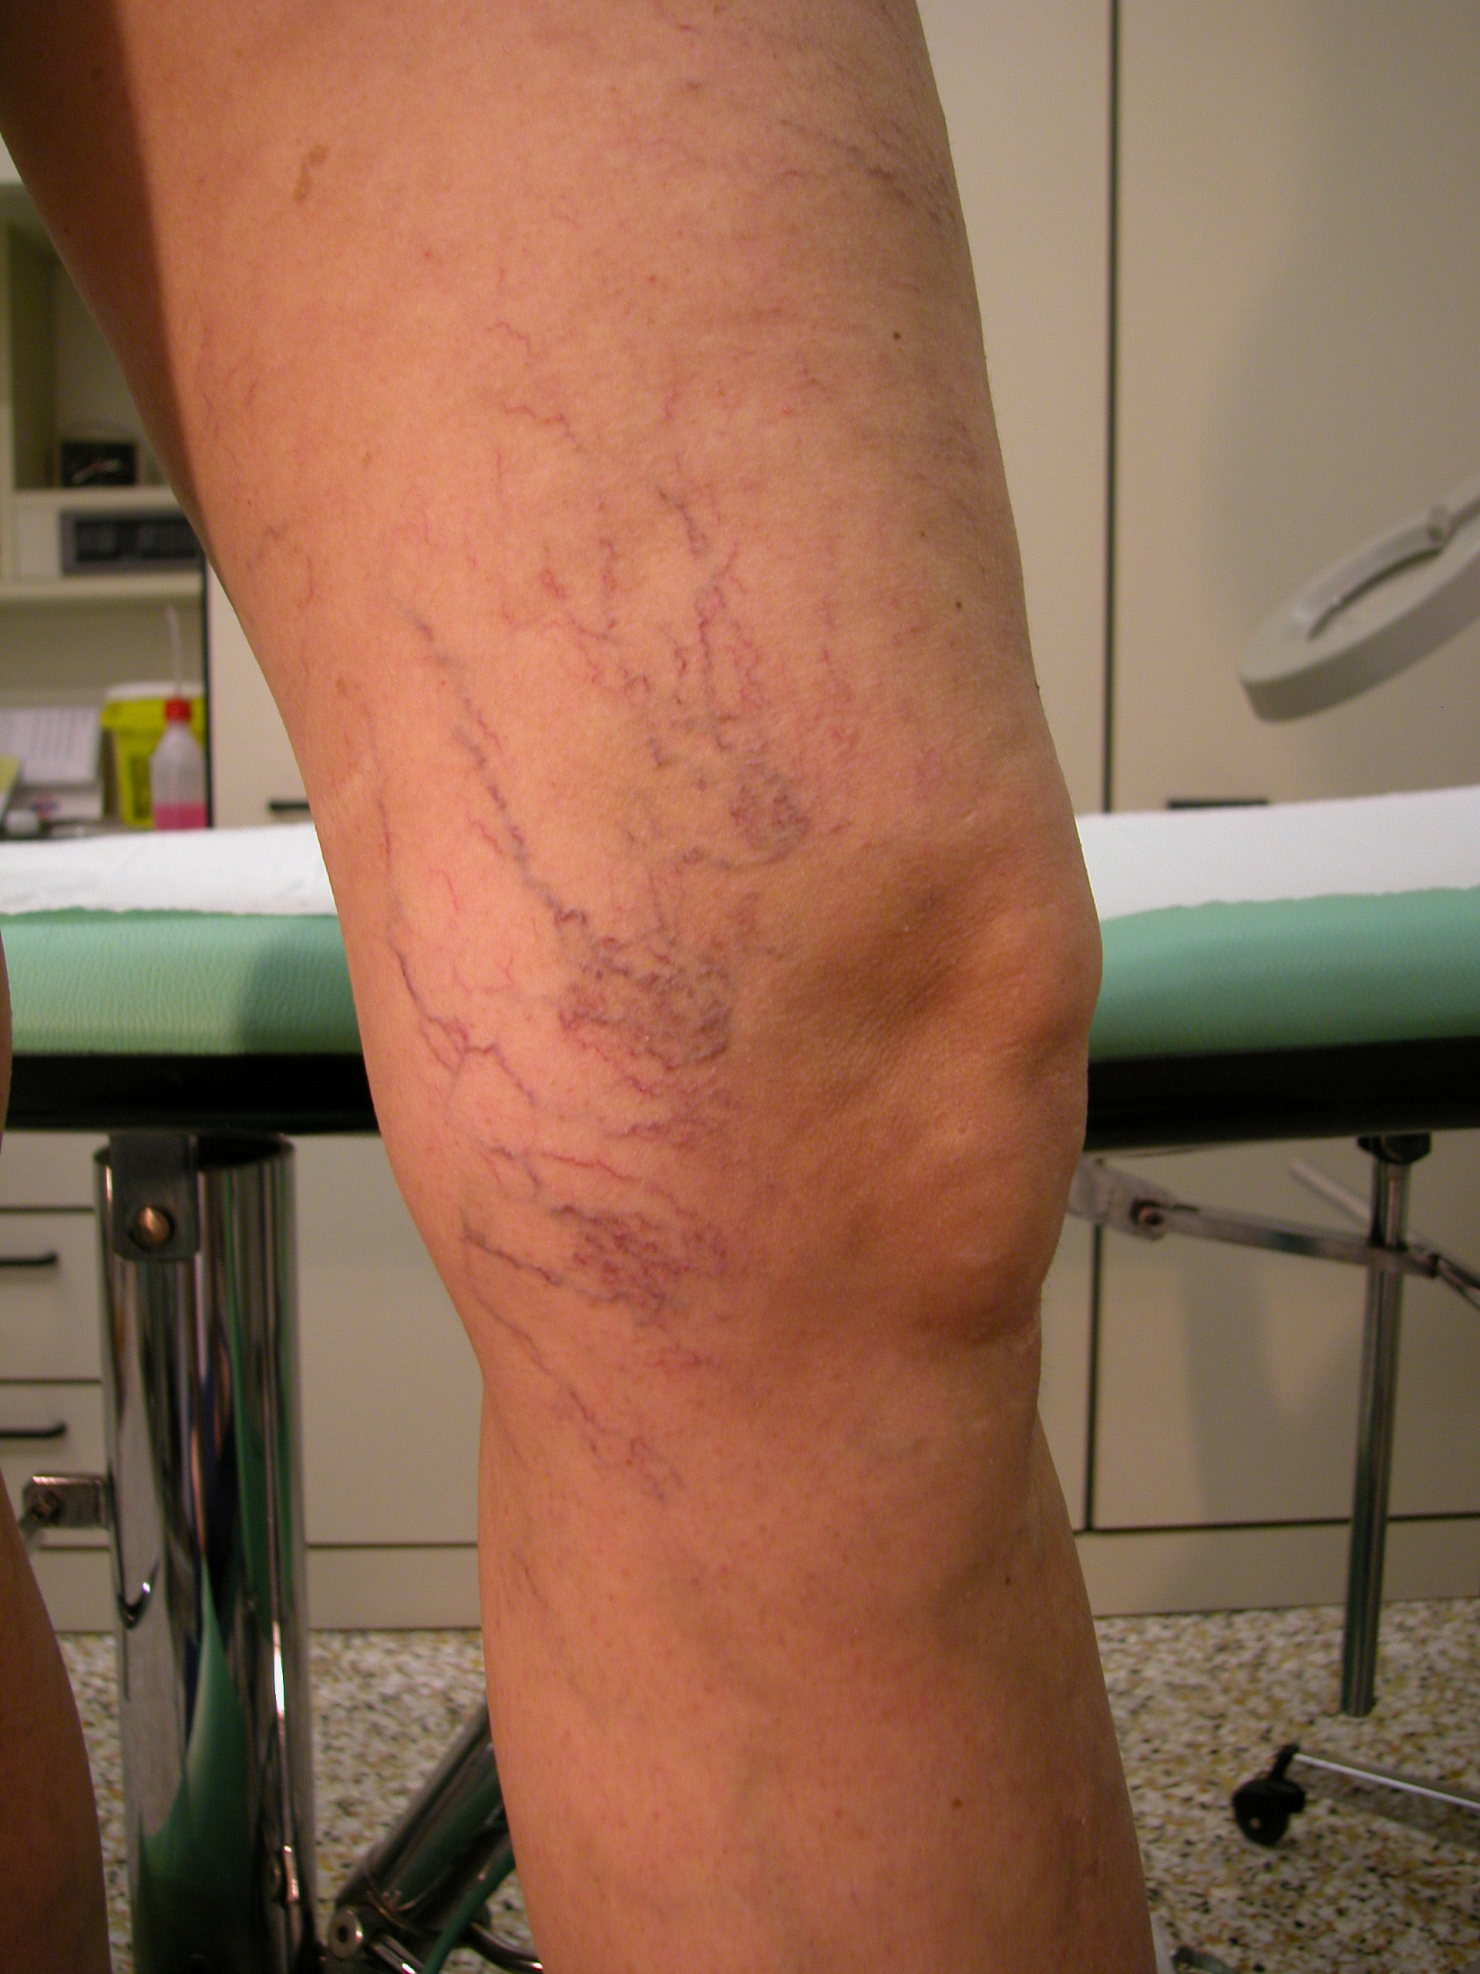
Anatomy of the telangectasia tree :
With the hair up and reticular vein down
With hair down and reticular vein up
With reticolar veins mixed with the teleangectasias
This, according to gravitational low, suggest the ipothesis that the reticular vein
When is up is a filling vein
When is down is a draining vein
Filling Vein
Draining Vein
Hidrostatic pressure and Doppler check up can help us to detect the direction of the draining gradient

Slide 7
Telangiectasia hair Down - postural changes and function of the reticular vein above
Hydrostatic gradient change it’s direction and from a filling gradient becomes a draining gradient

Slide 8
Telangiectasias hair Down - postural changes and function of the reticular vein above
In the situation B the inversion of the gradient is slowed by the tortuosity of the reticular network.

Slide 9
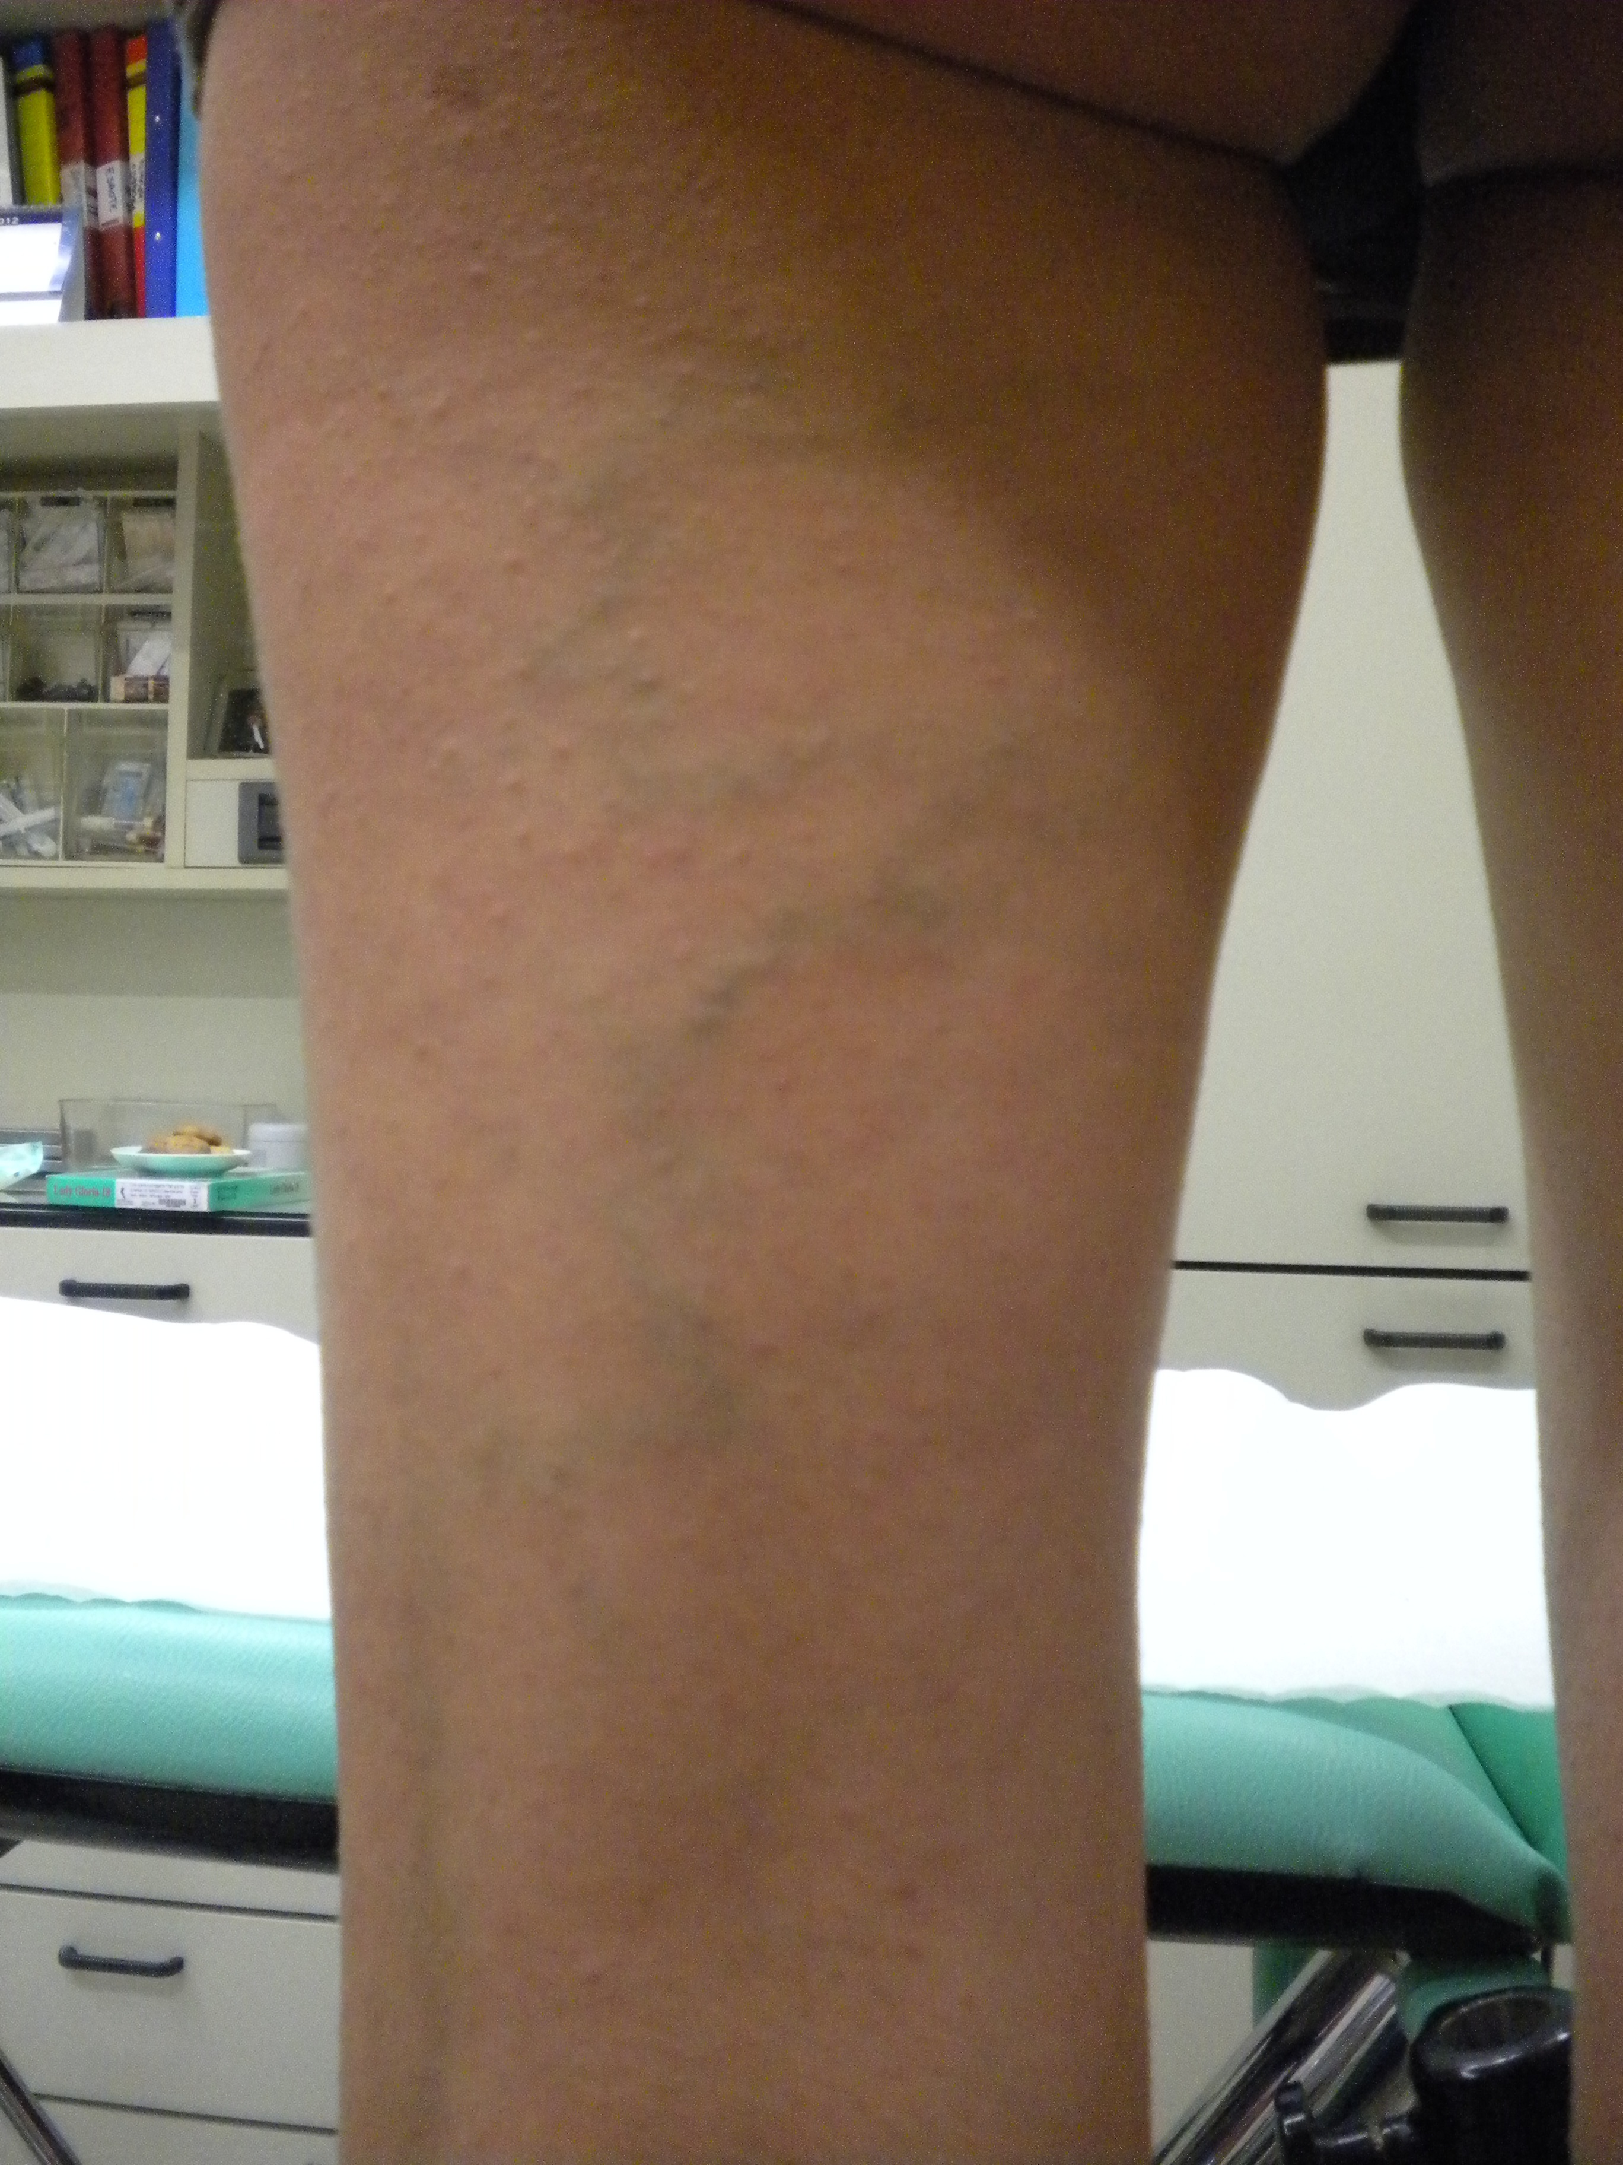
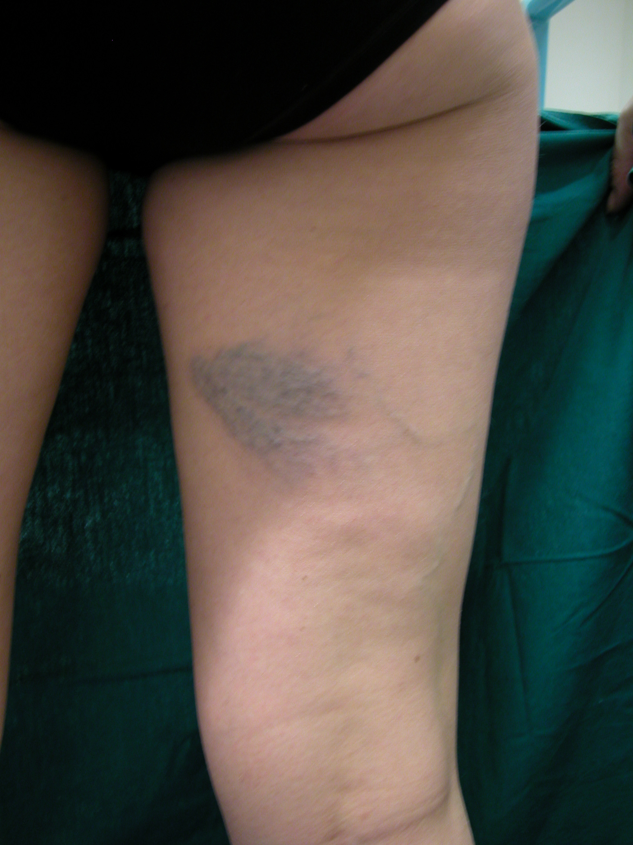
Telangiectasias hair Down - Origin of the reticolar network
1) The reticolar vein does not have a defined source
2) The reticular vein originates from a refluxing point
1) Whithout escape point
2) From Point P

Slide 10
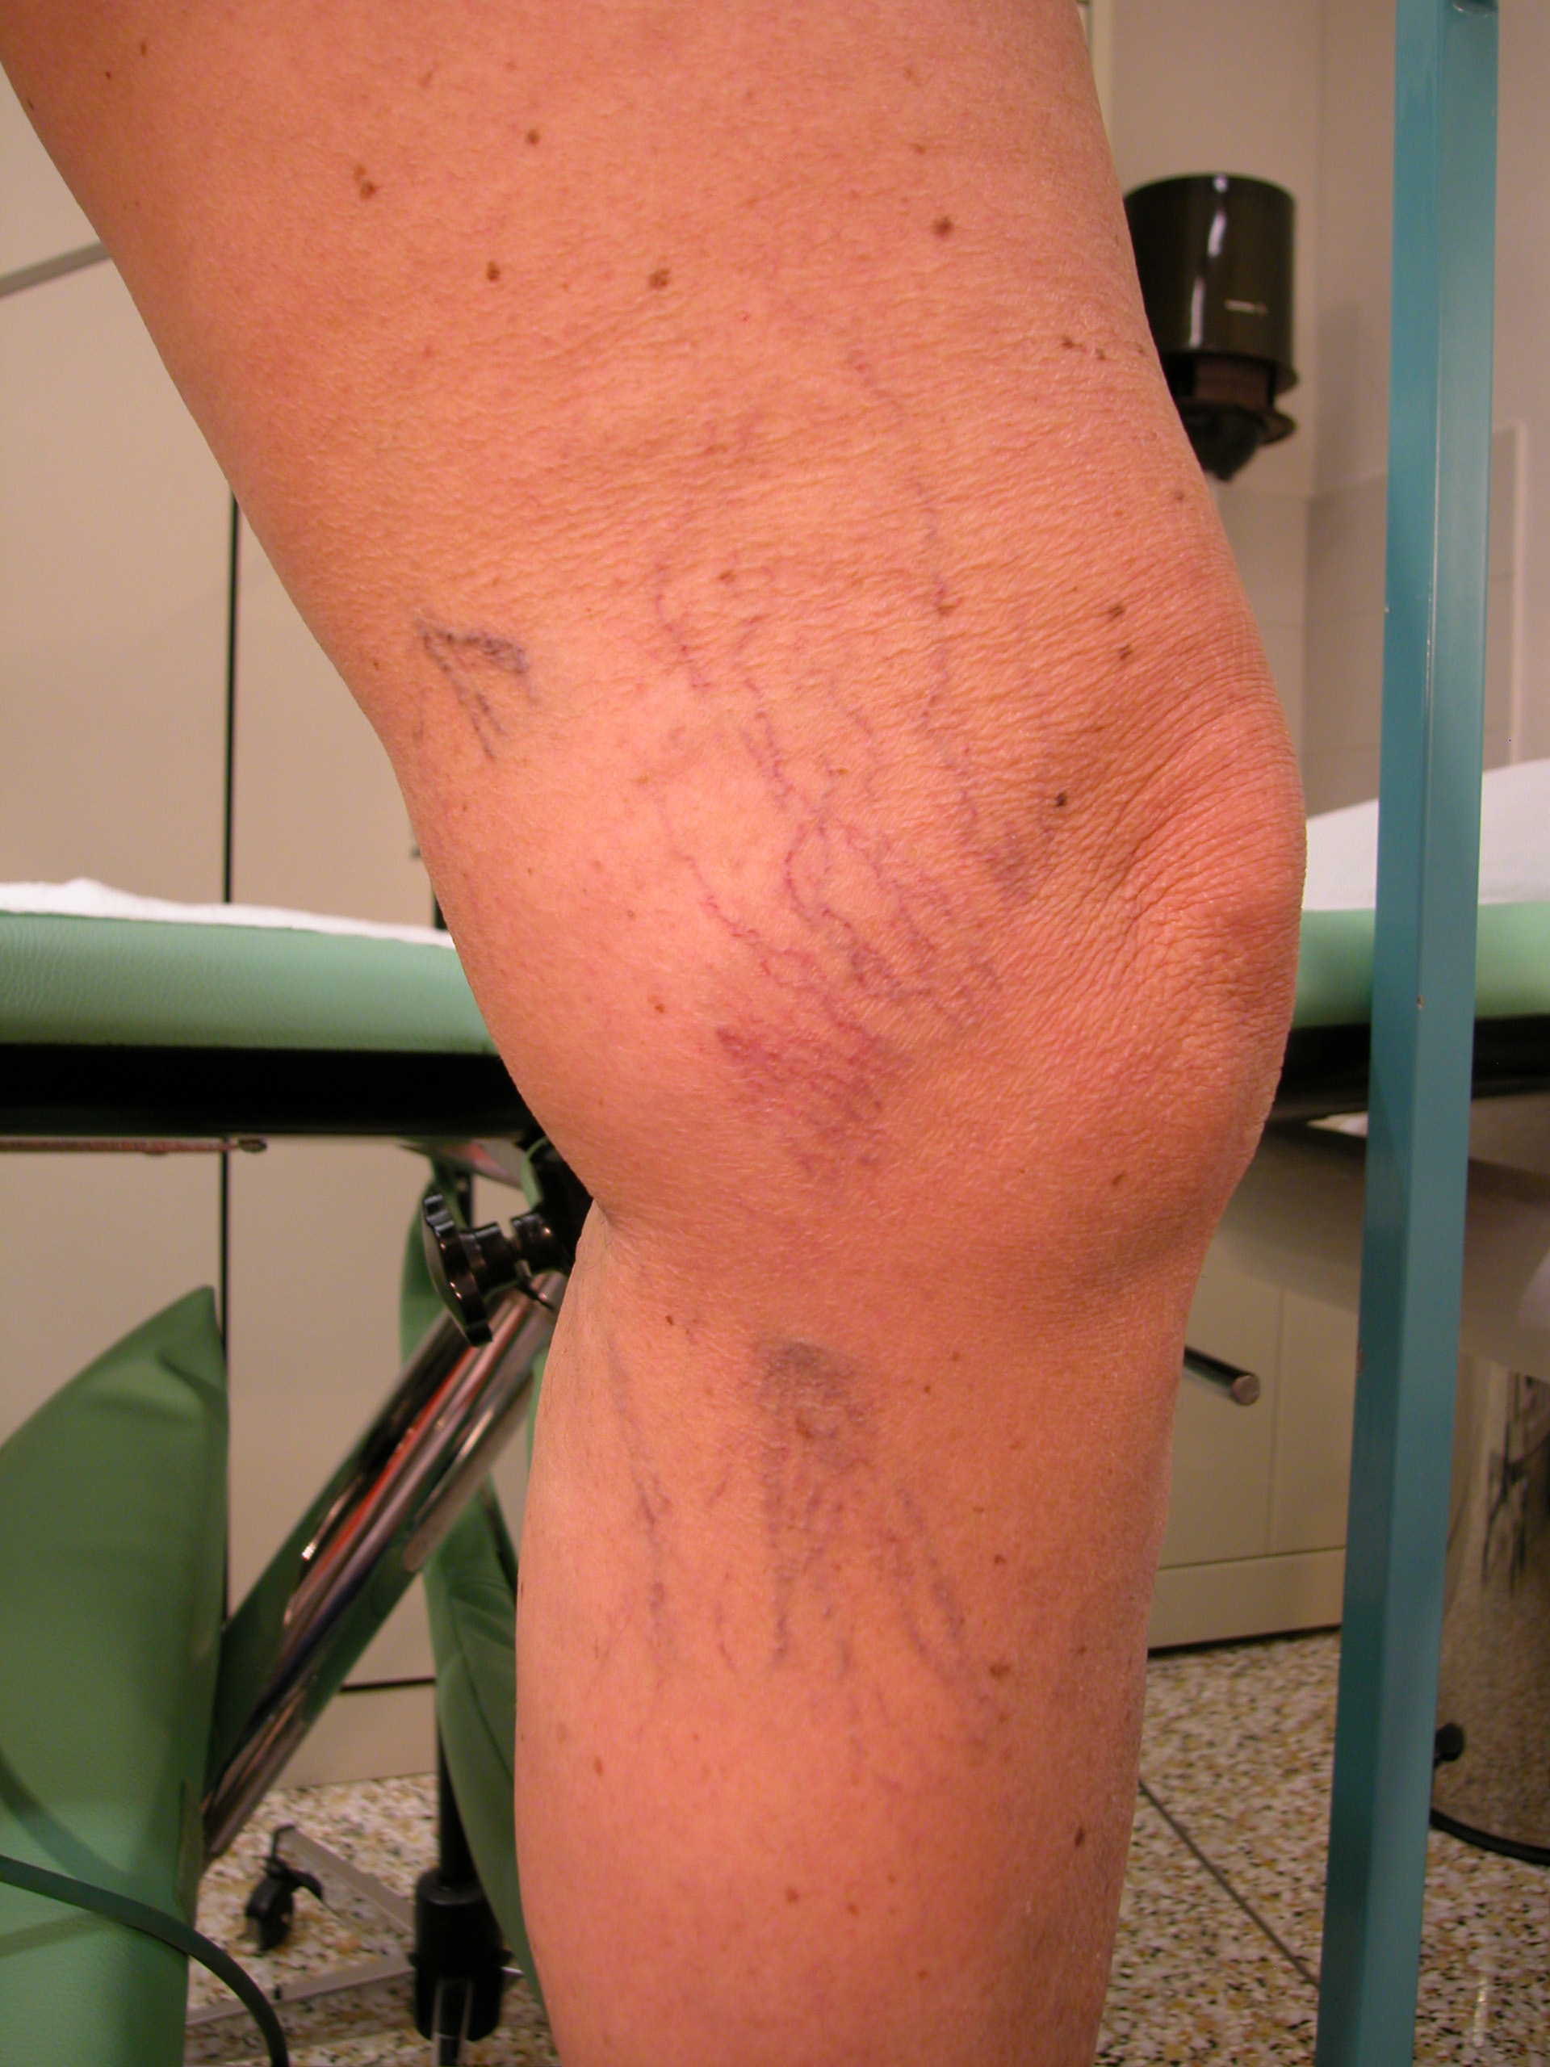
In all case the sclerotherapic treatment of the reticolar vein leads to the reduction of the telangiectasia
If this filling vein originates from the drainage of other telangectasia or from cellulitis, it’s suppression increases the risk of matting occurrence

Slide 11
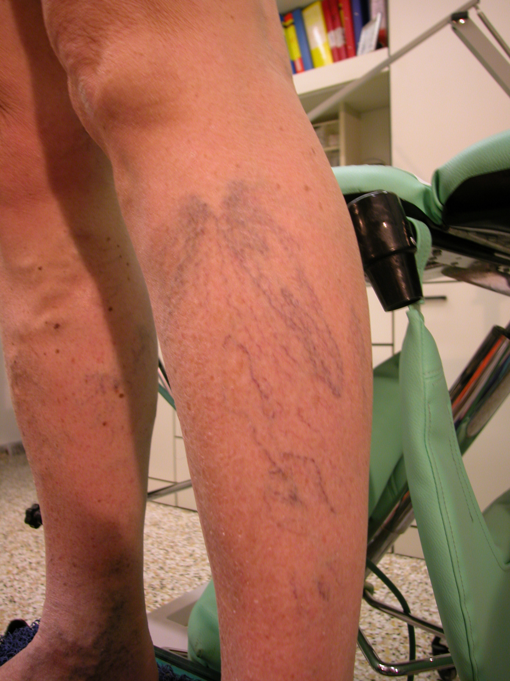
The filling vein of an hair down telangiectasia may be also the draining vein of a critic zone … Attention !!!
cellulite
3) Appearance of a matting
1) Sclerotherapy of the reticolar v.
2) Reduction of the telangiectasias

Slide 12
If the reticular vein originates from an escape pointpoint , this have to be invistigated and correctly treated.
N3
N2
Perforator vein or connection with an N2 system
Test Valsalva
Diastolic retrograde flow
Subcutaneous
Subfascial

Slide 13
Doppler check-up for telangectasia hair down
Valsalva test
Squeezing test
Dinamic test
Pattern of a refluxing perforator vein:
Diastolic out-flow
Valsalva positive ( sometimes)
For N2 collateral vein check also a sistolic reflux

Slide 14
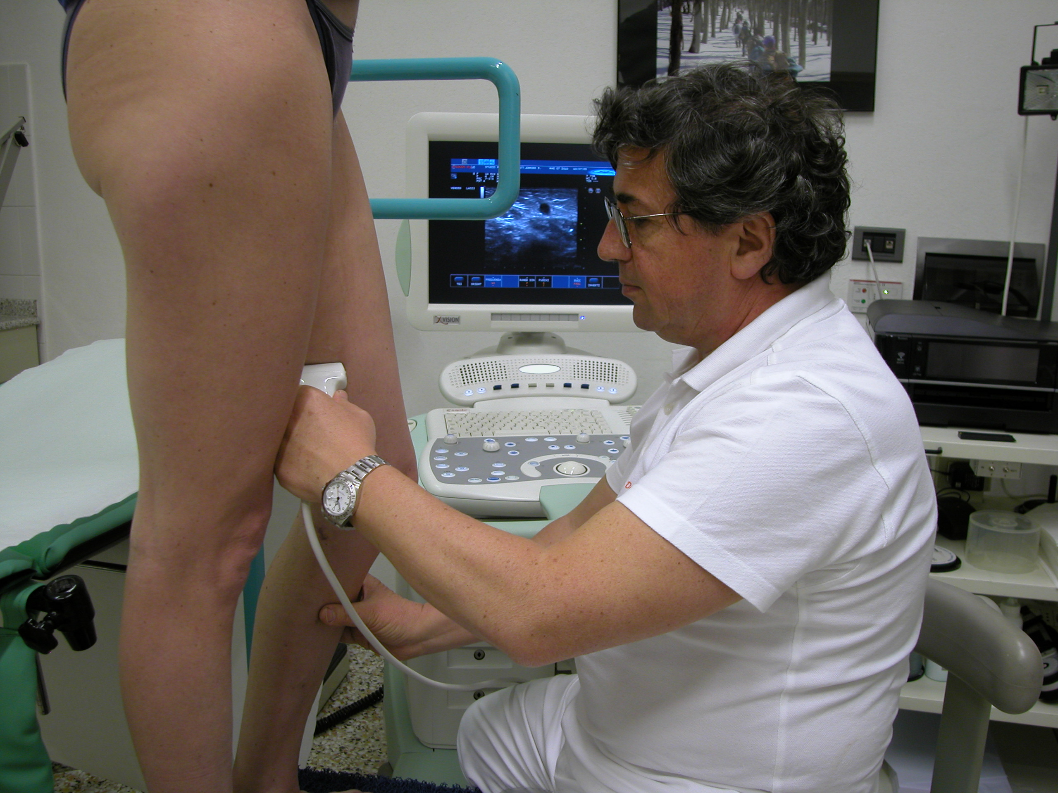
This means that especially the telangiectasia hair down must be carefully invistigated whit the hight resolution ecography ( 12-18 Mhz probe ) and with the transillumination.

Slide 15
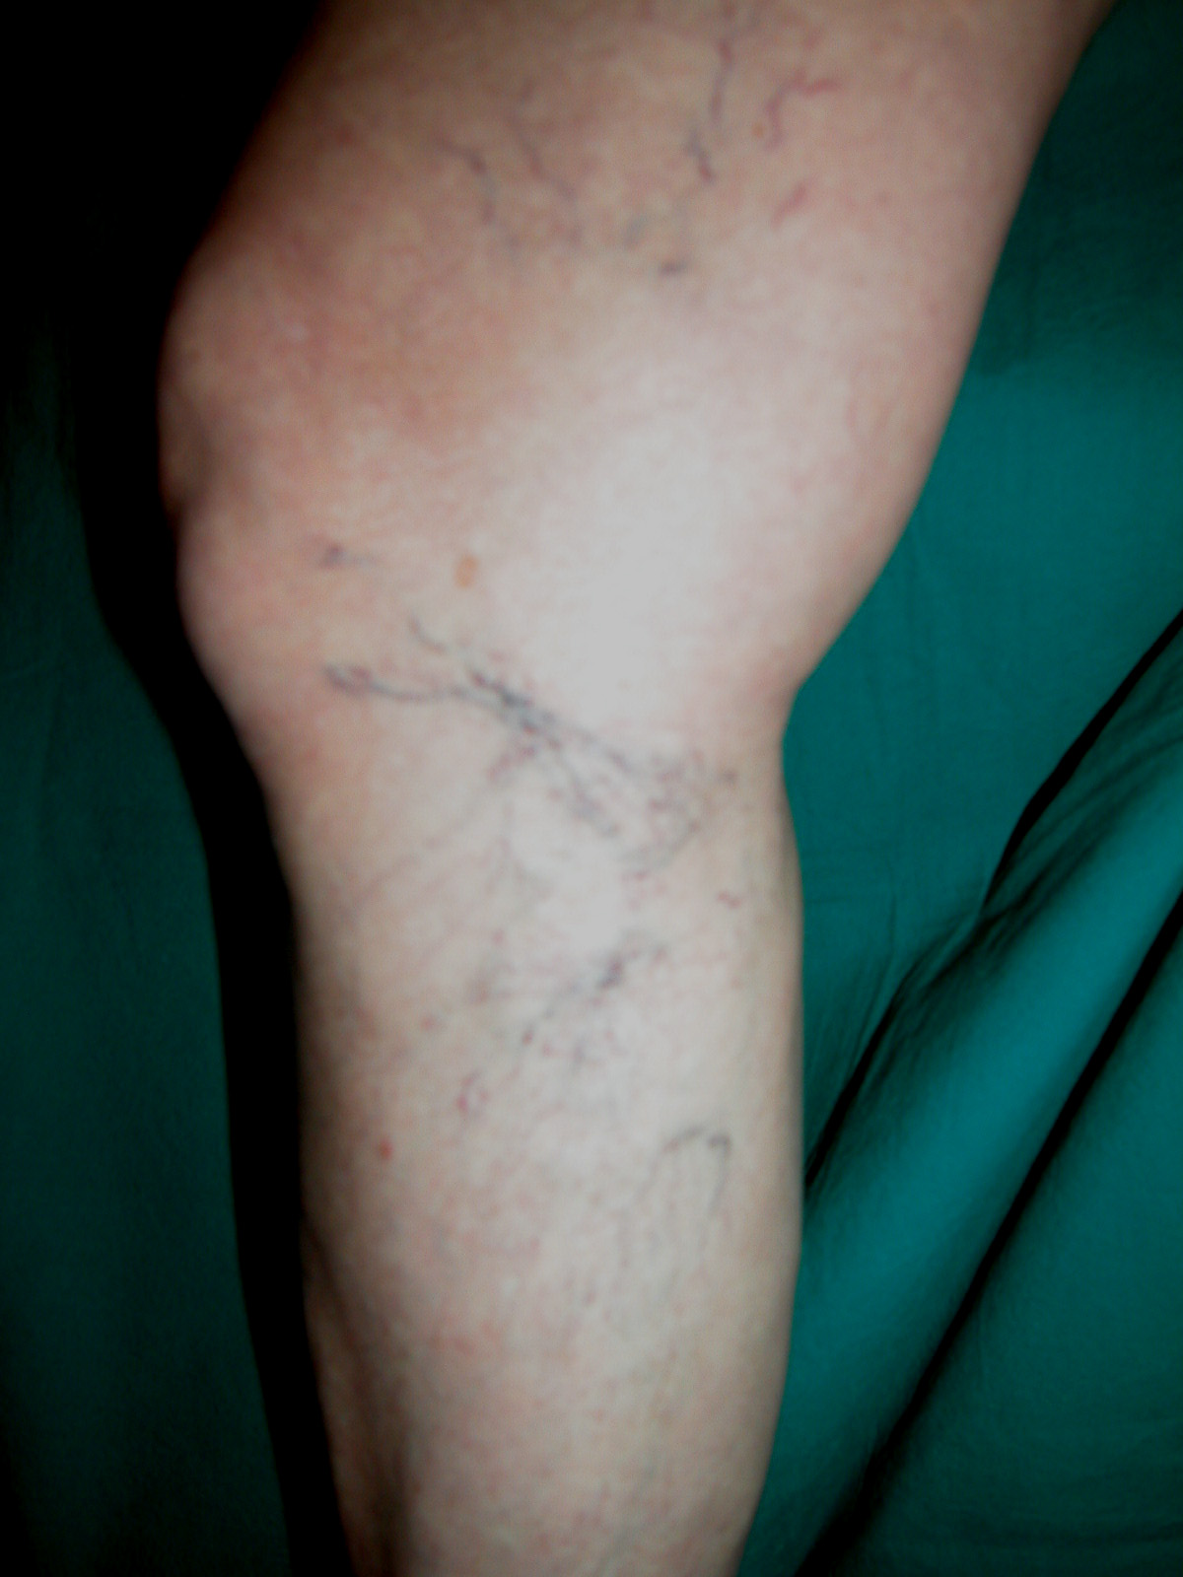
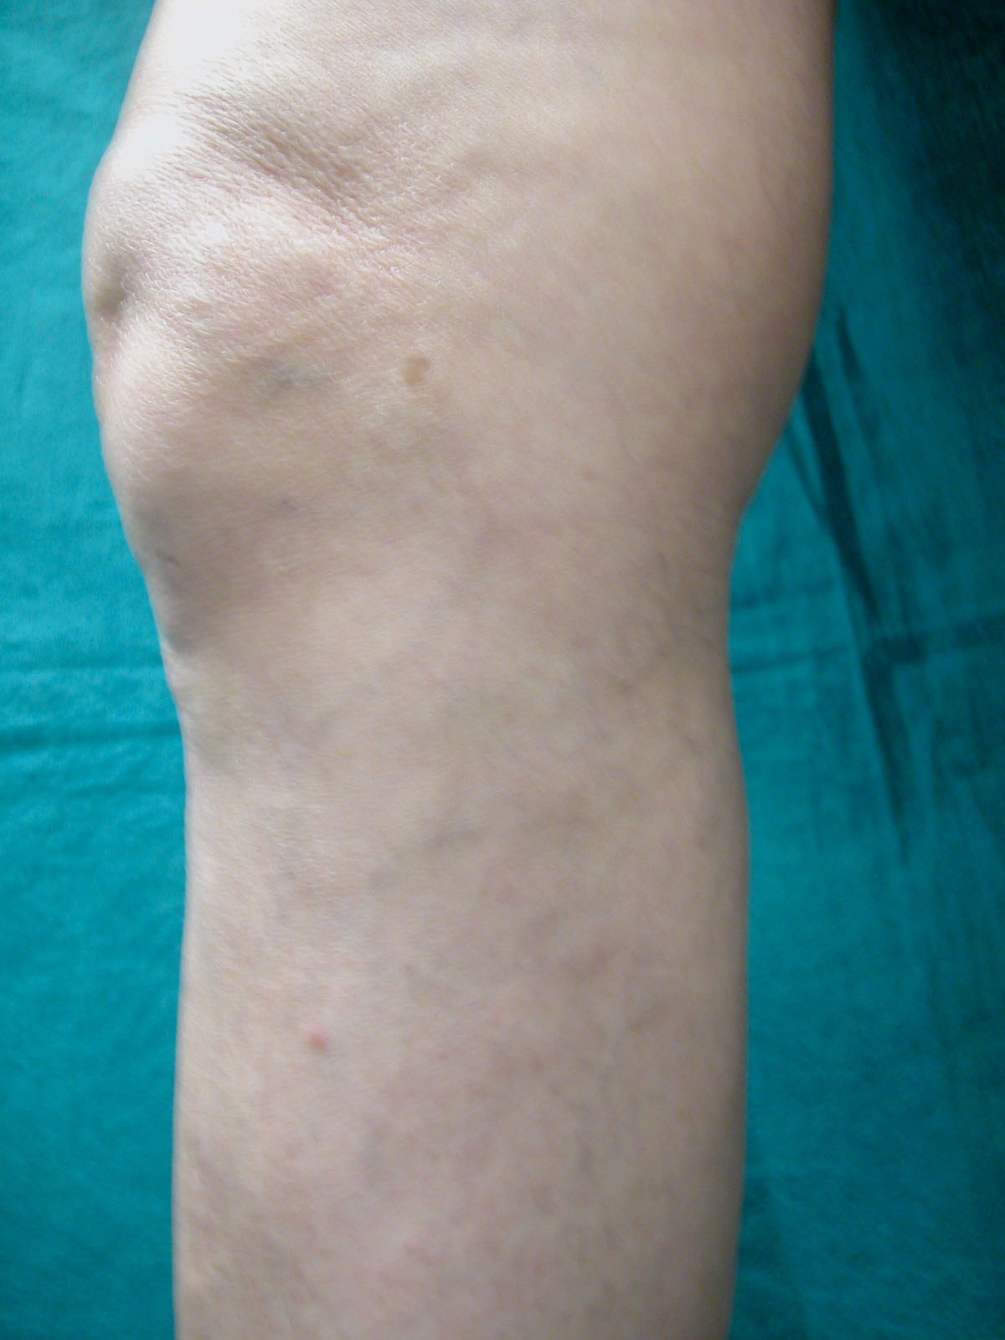
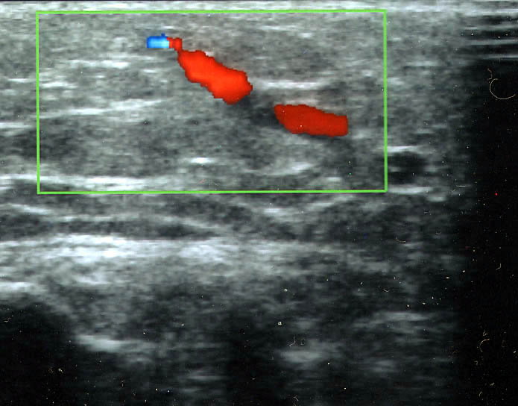
Telangiectasias filled by a saphenous tributhary refluxing during muscle systole
Coll.
Saf.Int.
Result obtained by sclerotherapic treatment of the refluxing tributhary

Slide 16
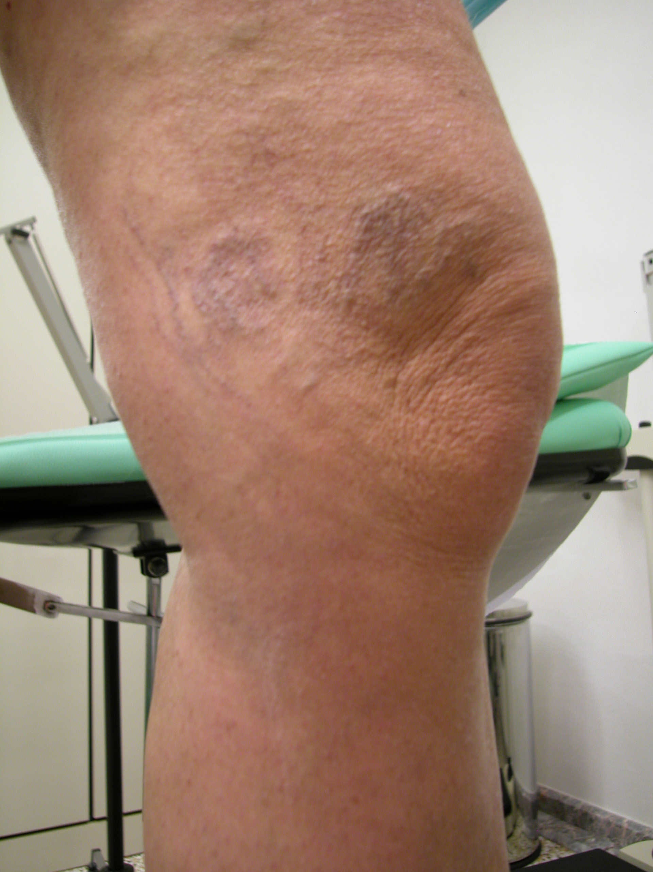
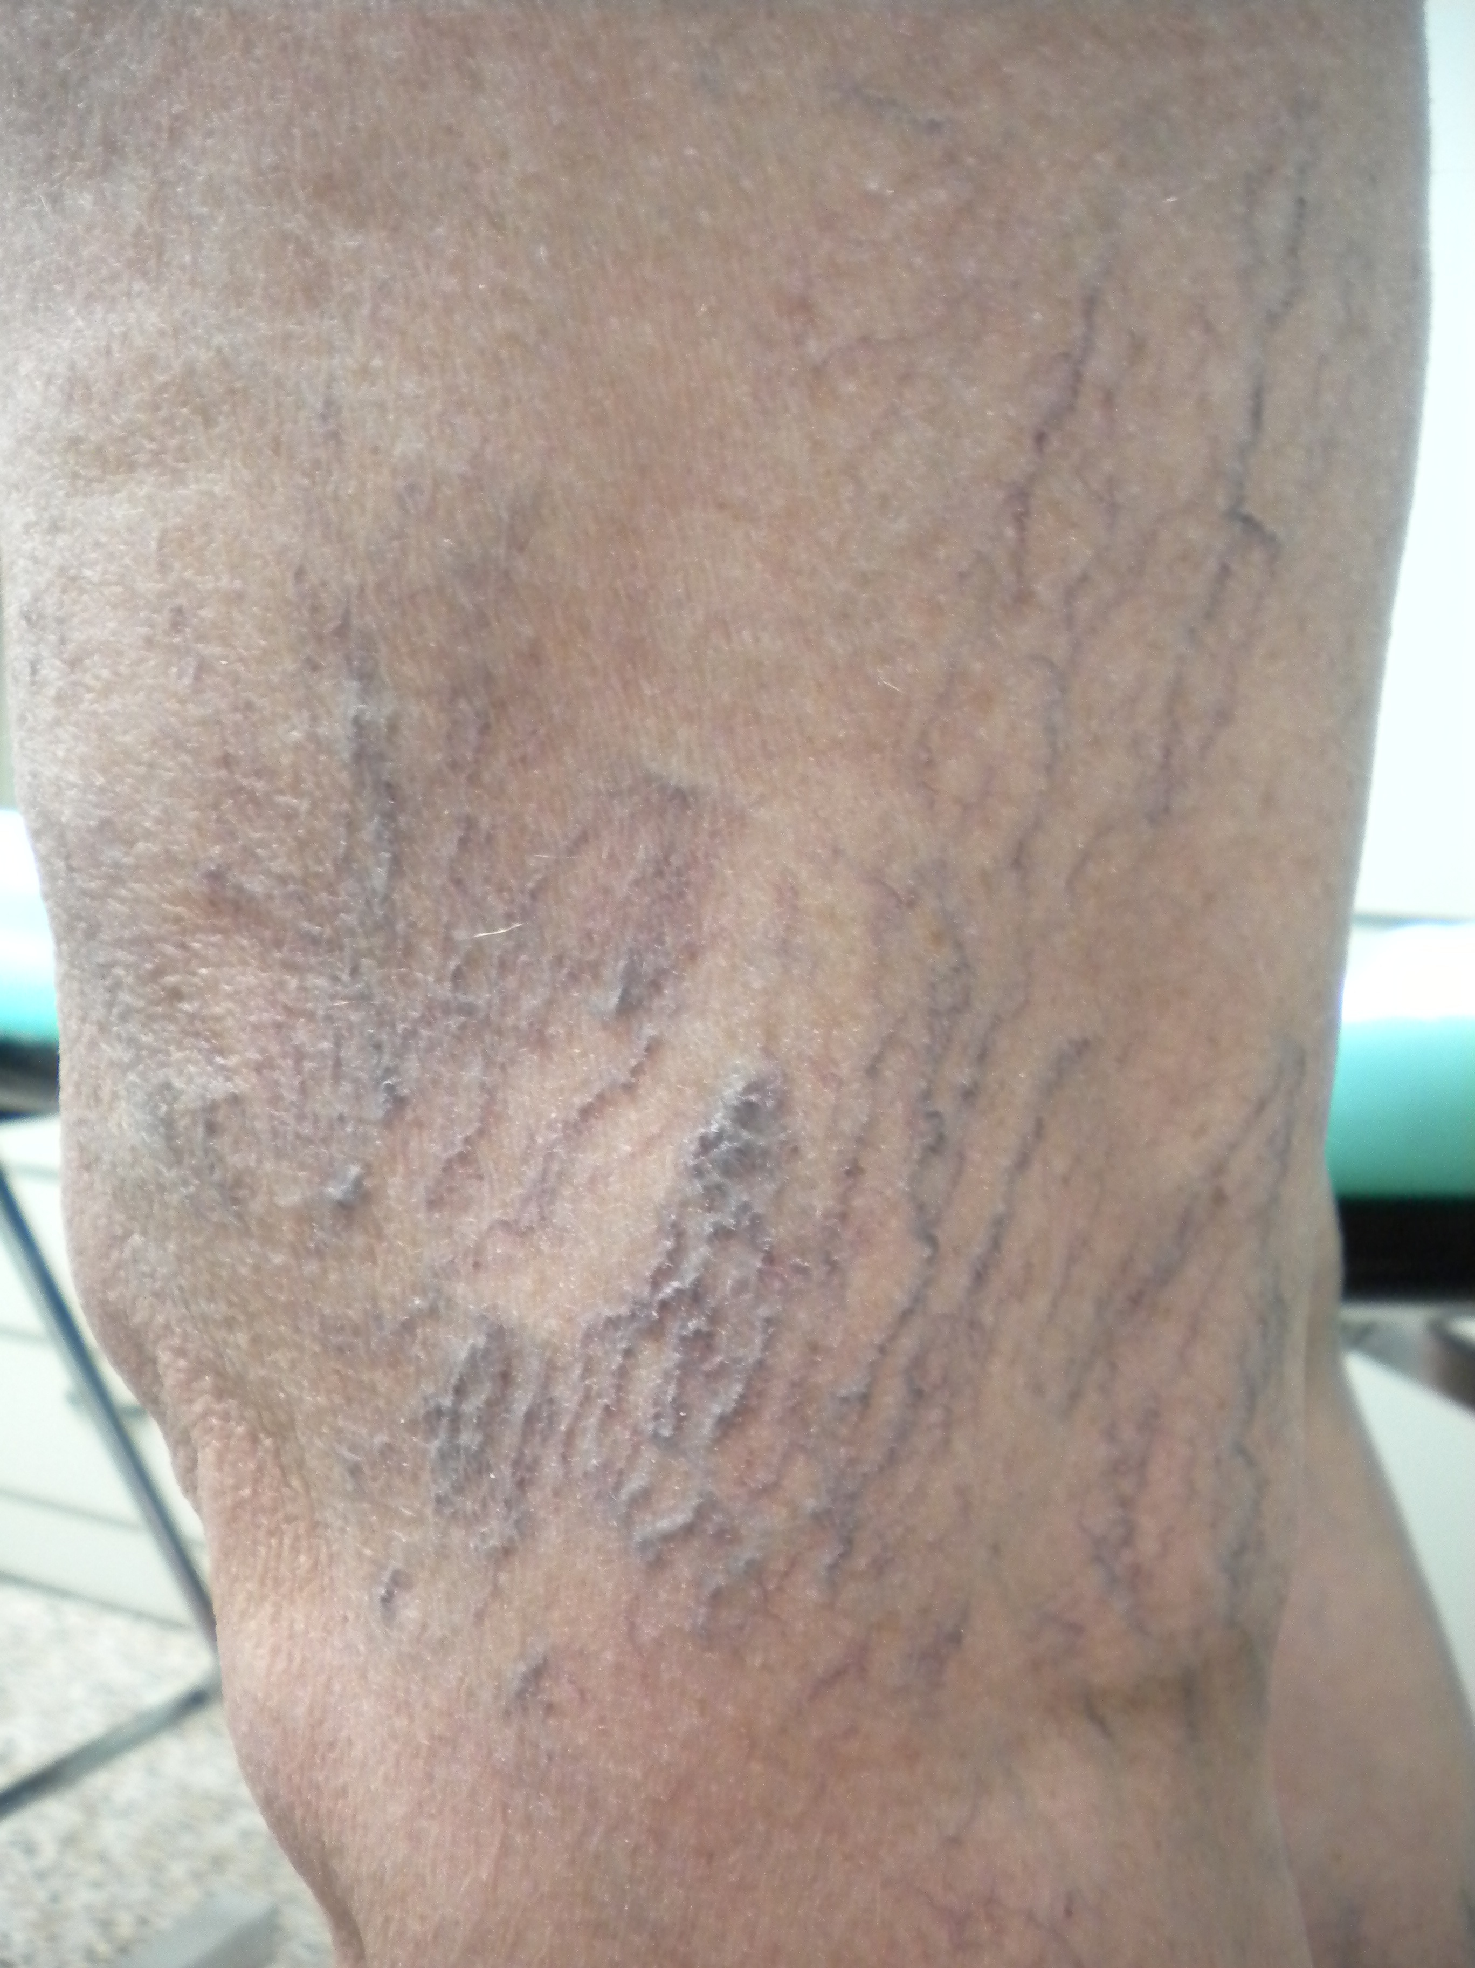
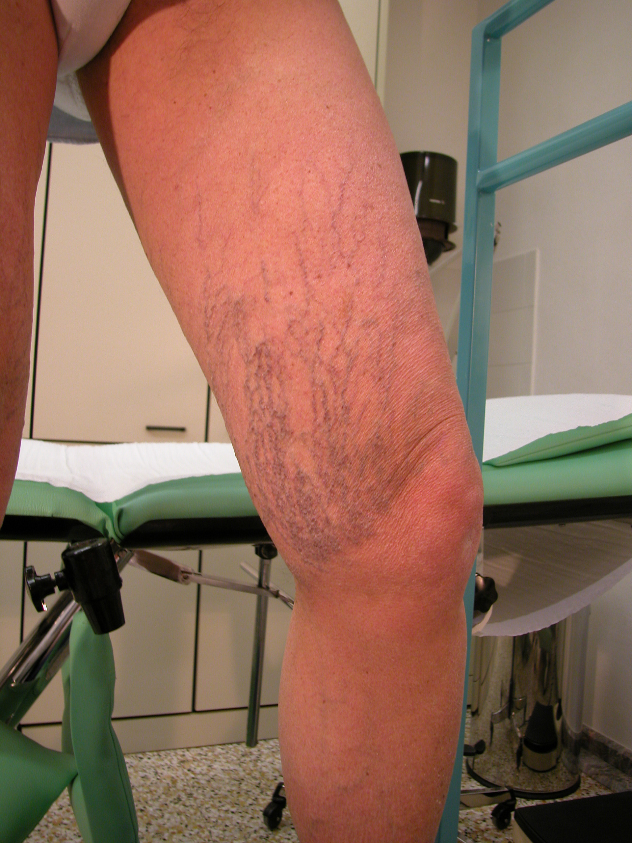
Teleangectasia Hair Up and Mixed

Slide 17
Postural changes of telangiectasias hair up and mixted
Standing Position
Venous pressure in Telangiectasia = residual pressure ( emptyng rate) - draining gradient ( MP activity , dgh )
dgh

Slide 18
Postural changes of telangiectasias hair up and mixted
Leg up
Venous pressure in Telangiectasia = residual pressure ( emptyng rate) + static pressure of the reticular system
worsens or does not change

Slide 19
Postural changes of telangiectasias hair up and mixted
Yes postural changes
No postural changes
A
B
In the situation B the trasmission of the energy of the MP to Telangiectasia is reduced by the tortuosity of the reticular network.

Slide 20
Haemodinamic patterns of the re-entry perforator
Valsalva negative
No sistolic flux
Diastolic in-flow

Slide 21
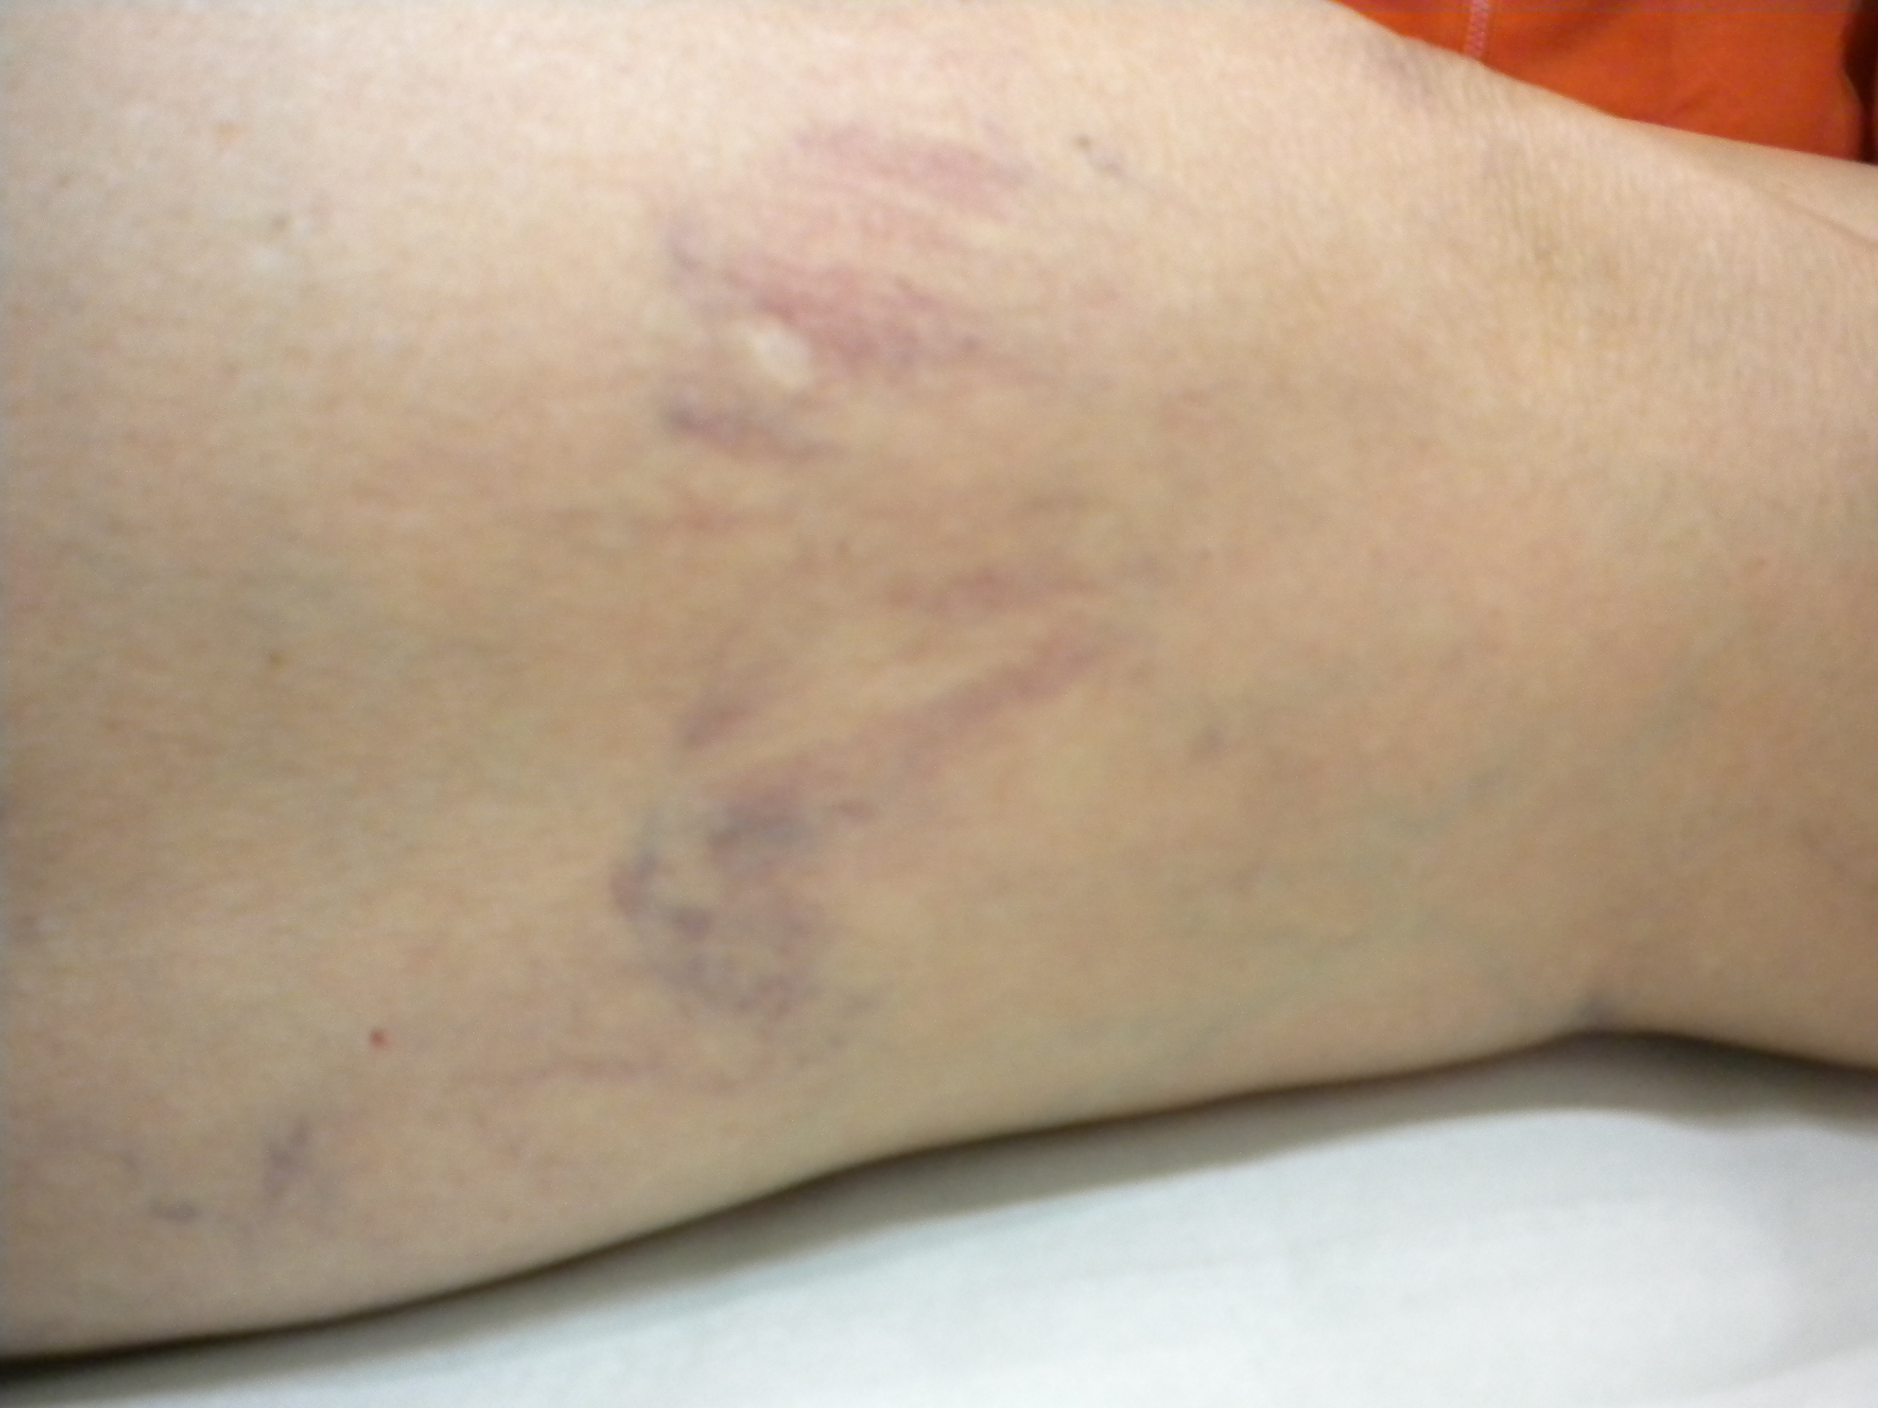
The draining gradient in Telangiectasia Hair Up
We have to respect the drainage system. It’s closure leads to the risk of matting

Slide 22
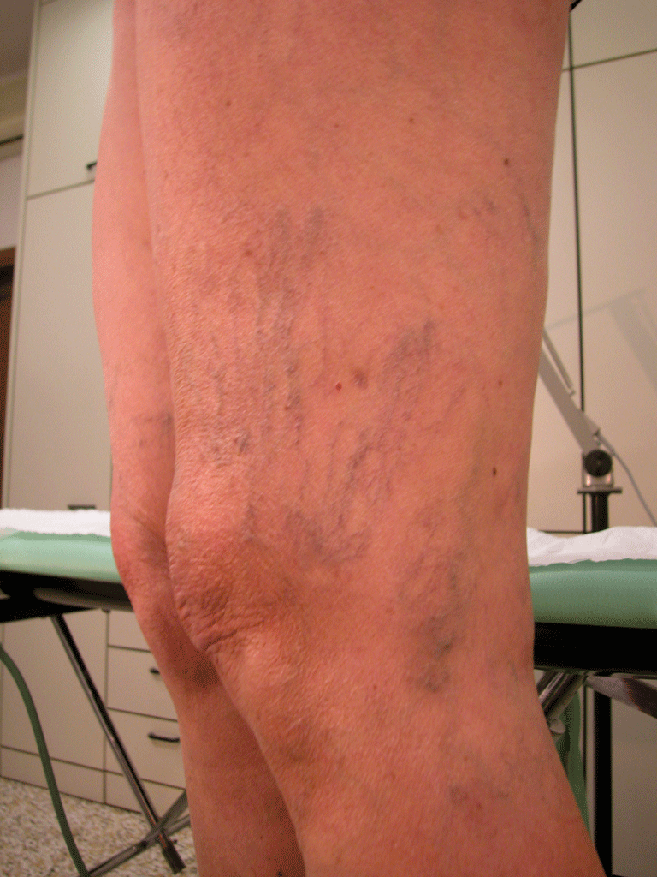
The filling gradient in Telangiectasia Hair Up
No reticolar vein above the telangiectasia.
Vedere ipotesi sul lavoro di molisso

Slide 23
Consideration about the phisiopathology of telangiectasia hair up
Telangectasia
New Draining system
Obstacle to Phisiologic drainage
PEF
Hair up Telangiectasia represent a vicarious circle

Slide 24
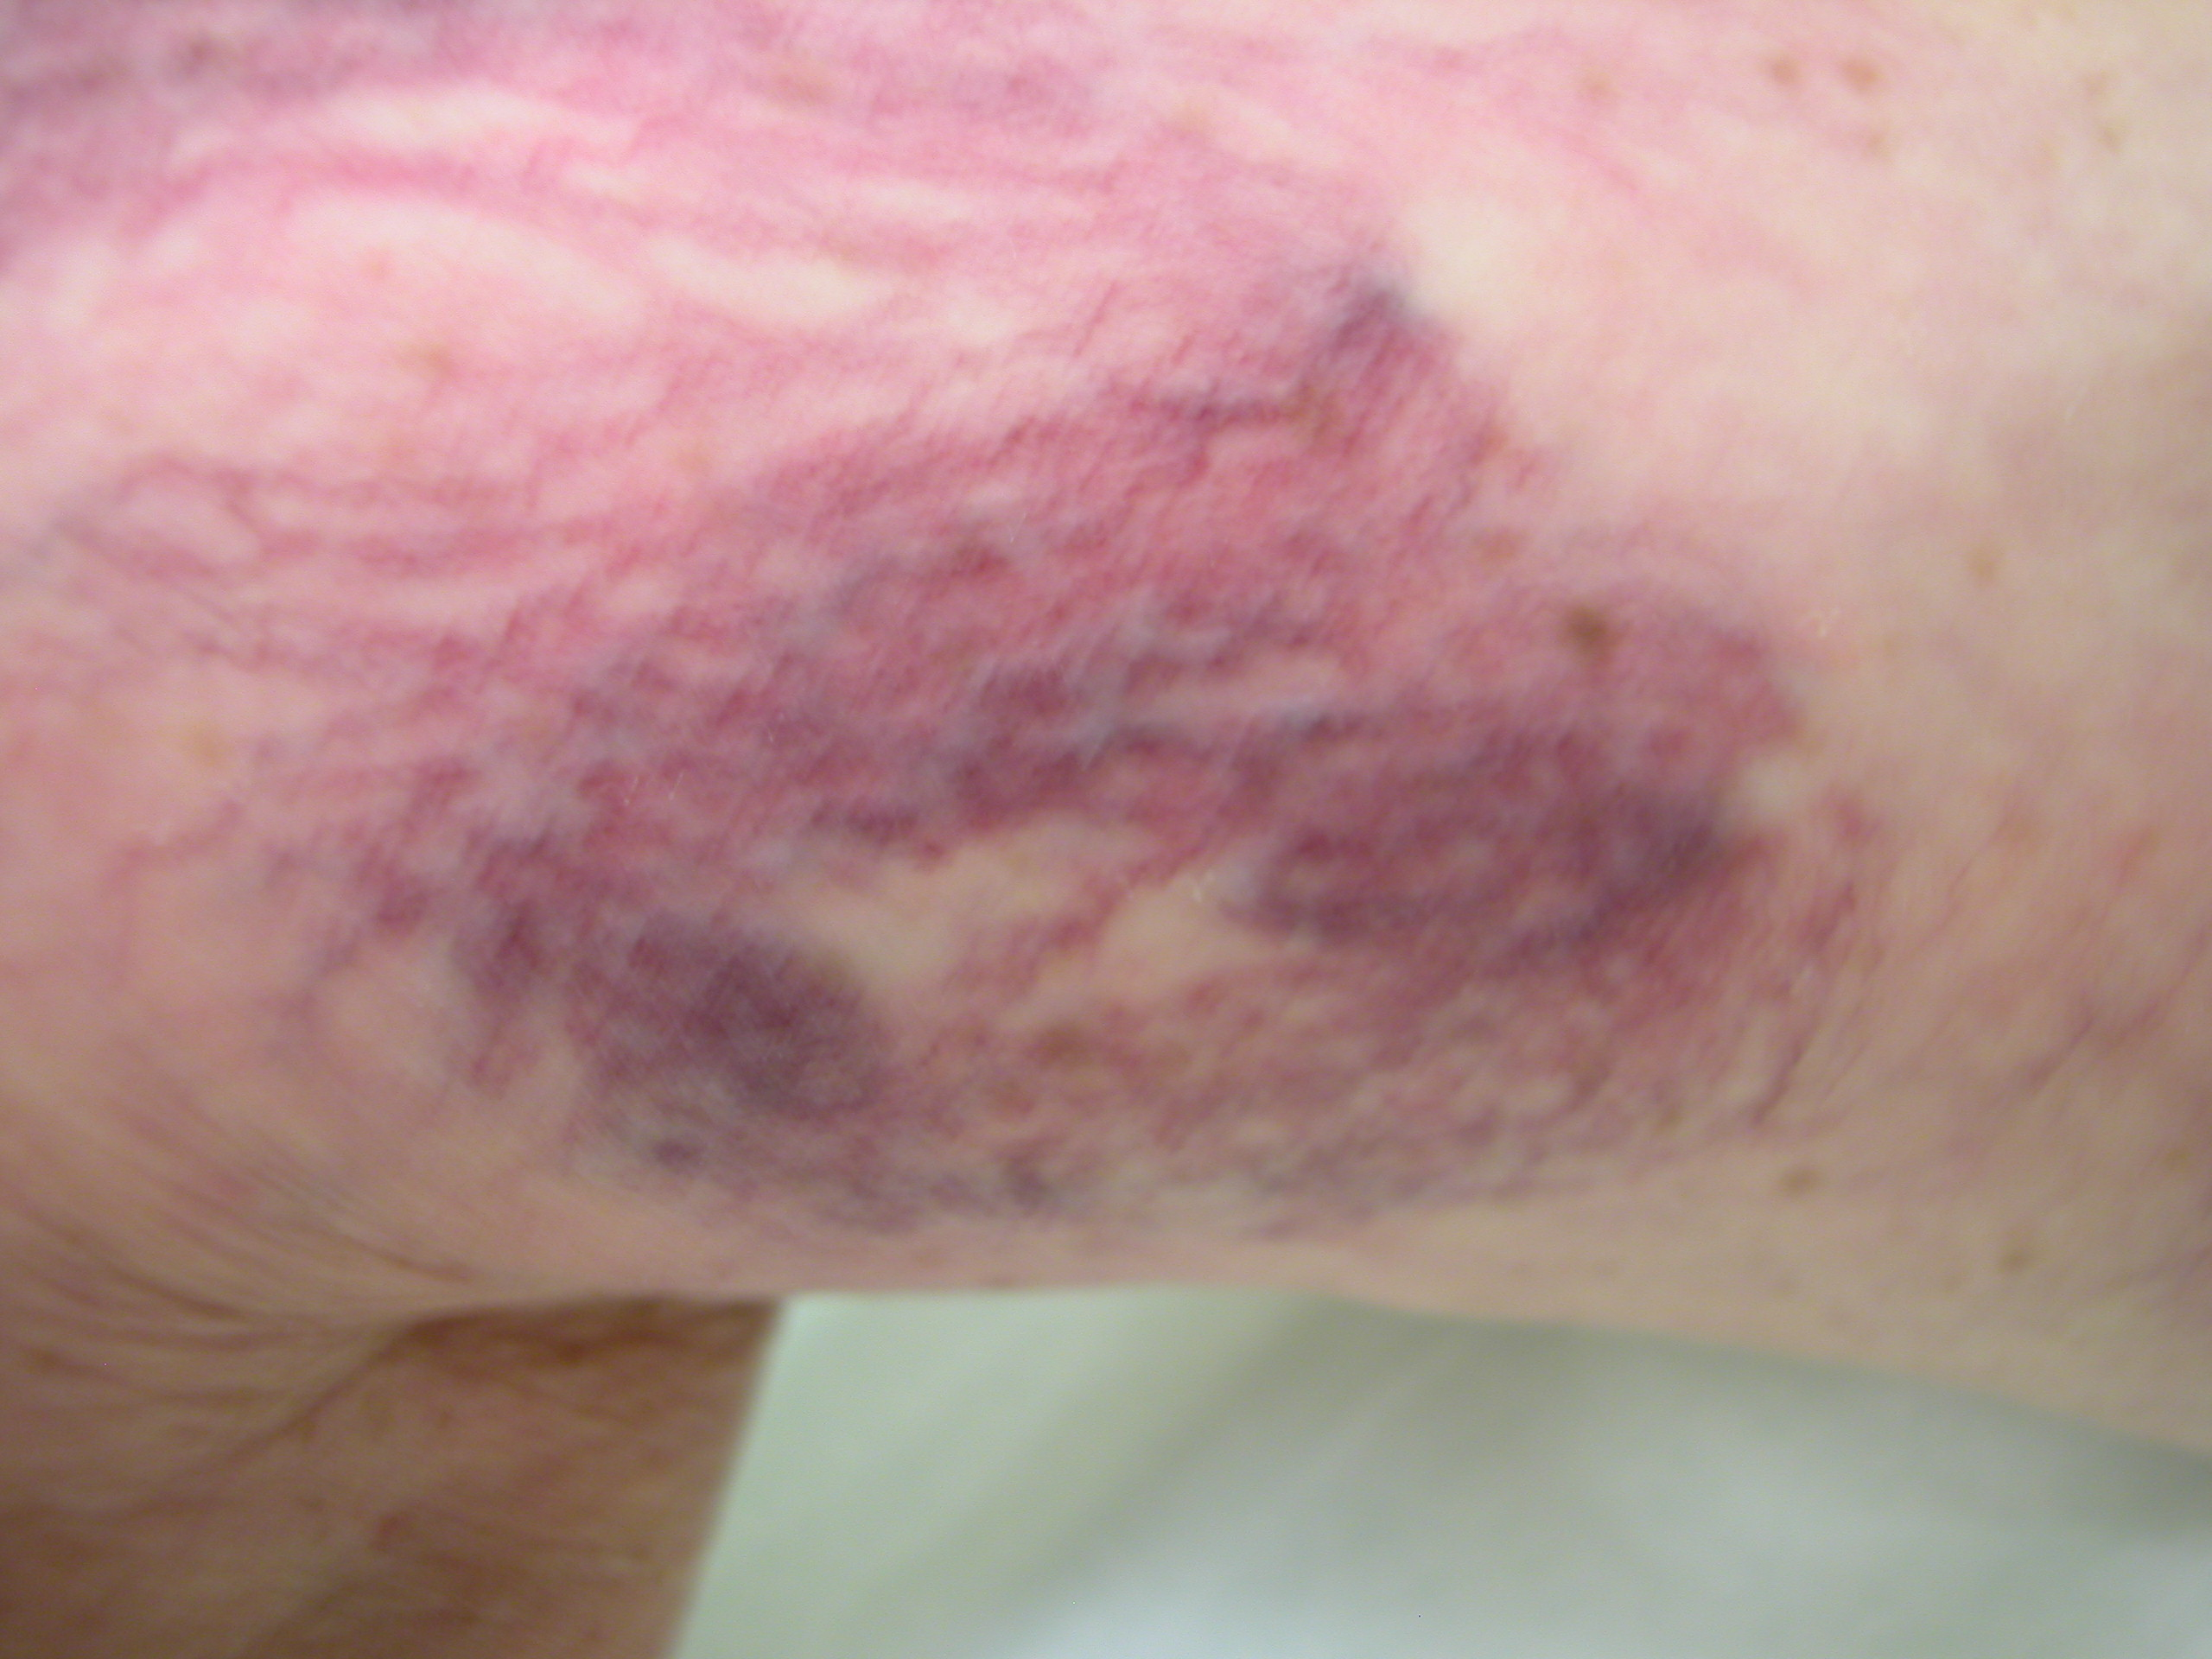
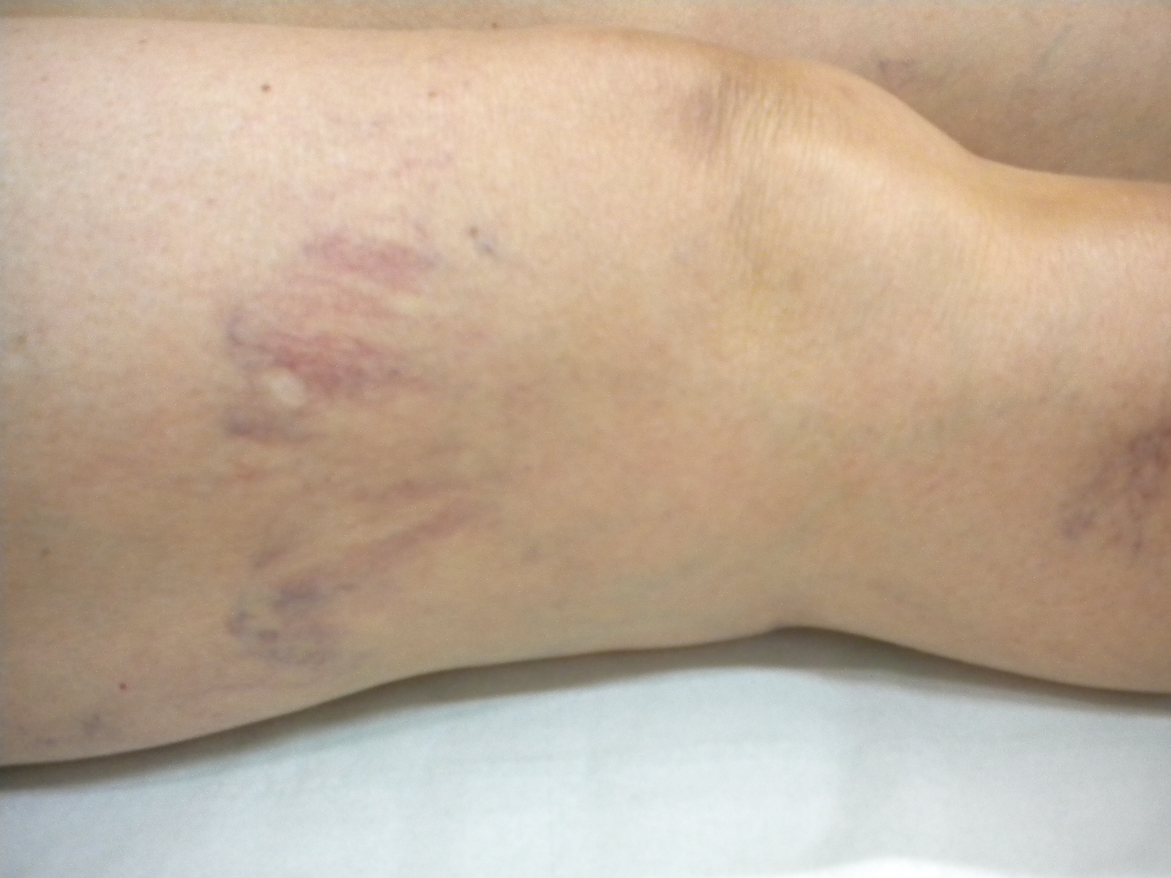
Eliminate the telangiectasia hair up corresponds to the suppression of a vicarious circle
More veins I close, more new veins form again , because I can’t modify the residual venous pressure
Chista è na fessiria !
Bad result due to excess of treatment

Slide 25
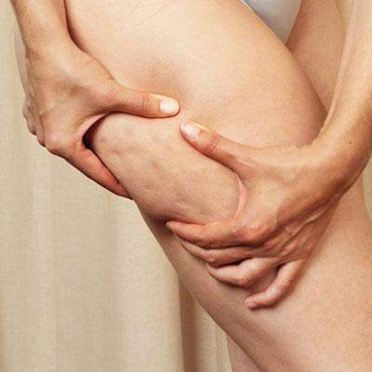
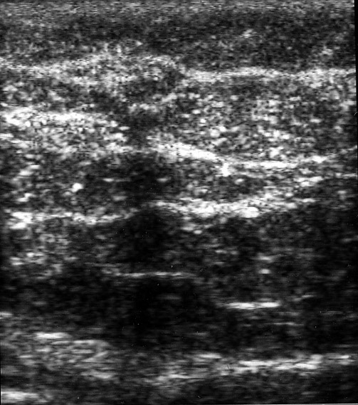
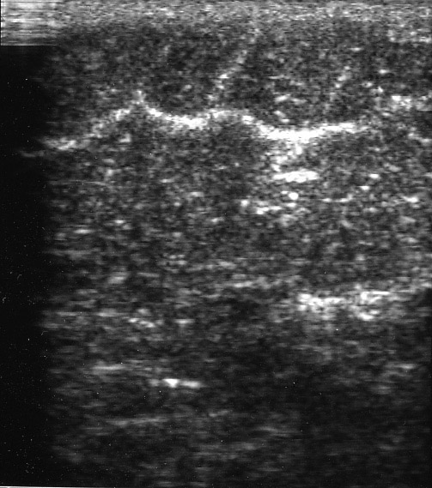
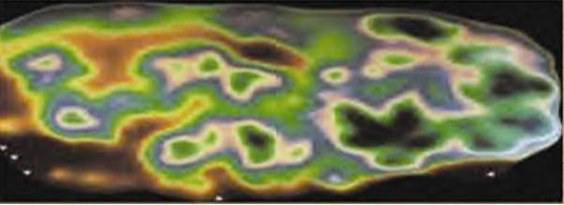
So the problem is not to improve the efficacity of the sclerotherapic treatment ( mousse, tecnique START etc.) but to promote a new draining way , not visible, and to prevent the matting.
Macronoduli e scompaginamento trabecolare
Tralci connettivali responsabili della “ buccia d’arancia”
Treat Cellulite.
Is it possible?

Slide 26
Light sclerotherapy , timing and elastick stocking run toghethers
Sclerotherapy closes ectasic telangectasias and hand in hand worsens venous stasis in cellulitis tissue.
Residual venous pressure try to find e new drainig way
Elastic stocking increases tissue pressure and preclude venous steatching and dilatation due to the increased lateral pressure .
So the draining volume of superficial tissue is limited by the compression, and new draining way will devolope where resistances to the flow are lower, ie, away from the skin.
So, step by step, sclerotherapy closes, the nature recreates, the elastic stocking guide.
Timing should allow time to complete the cycle

Slide 27
Guidelines for a good result according to these haemodinamic considerations
Timing of sclerotherapic treatments :1 treatment every 4 weeks
Light sclerotherapic agents
Medical treatment , sistemic draining drug and topic treatment
Compression by a 24 mm.Hg elastic stocking for 3 weeks (*)
Stop treatment at the right time ( before matting !! )
(*) =
Compression after sclerotherapy for telangiectasias and reticular leg veins: a randomized controlled study.
Kern P, Ramelet AA, Wütschert R, Hayoz D
J Vasc Surg. 2007 Jun;45(6):1212-6. Epub 2007 Apr 27.

Slide 28
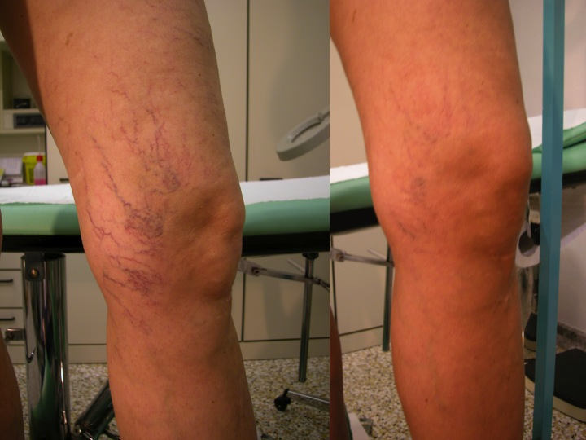
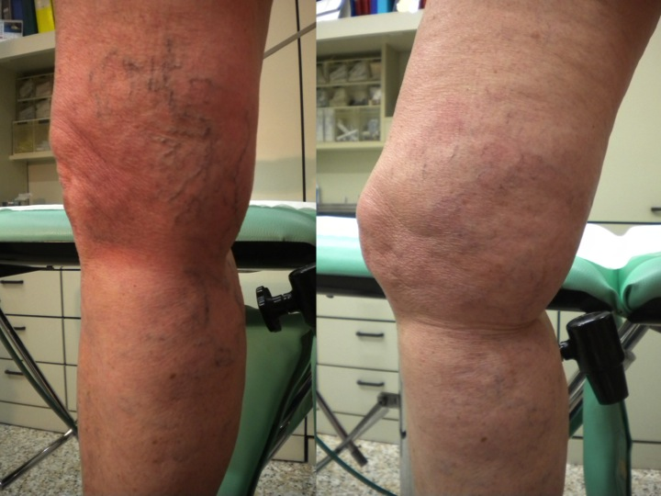
Small red telangiectasia :
STOP
sclerotherapyc treatment
CONSENSO INFORMATO
….. Il risultato finale dipenderà anche dalle cause e dalla estensione dei capillari e in alcuni casi non si potrà avere una completa scomparsa degli inestetismi cutanei, ma solo una loro attenuazione……

Slide 30
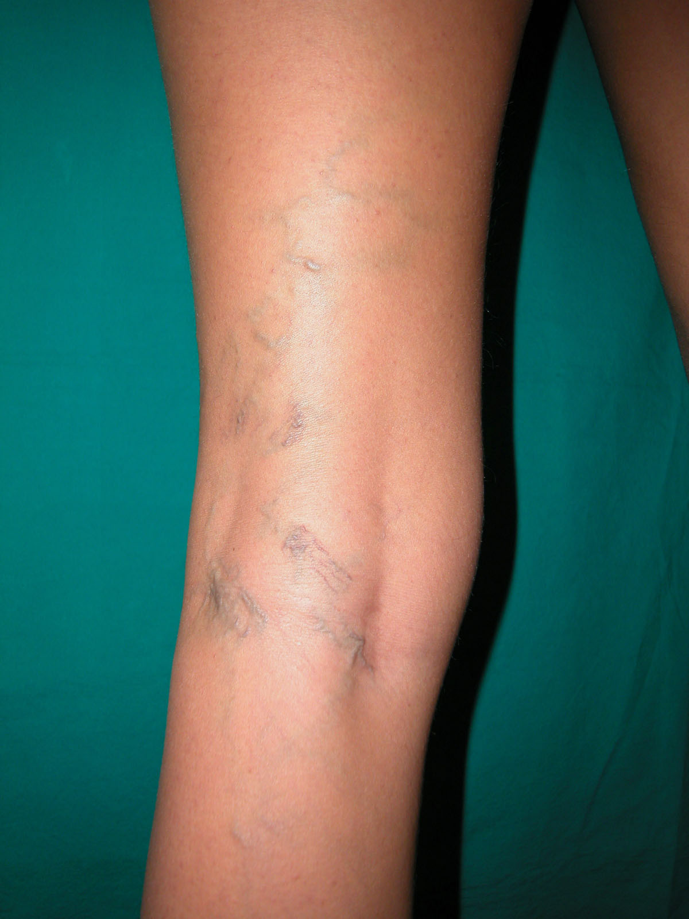
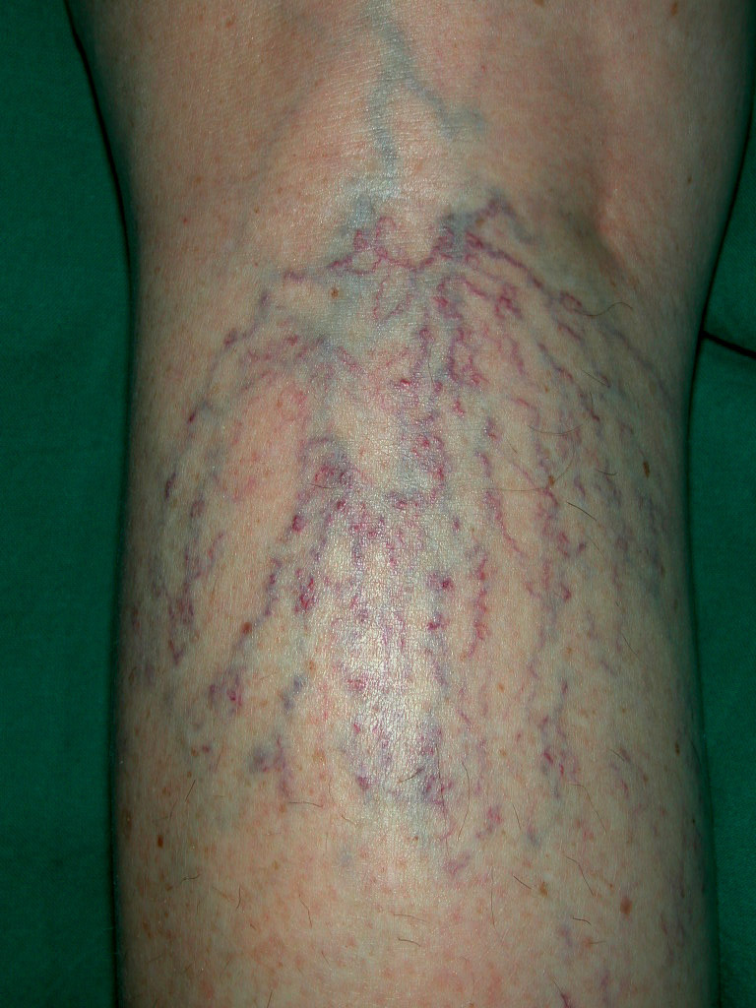
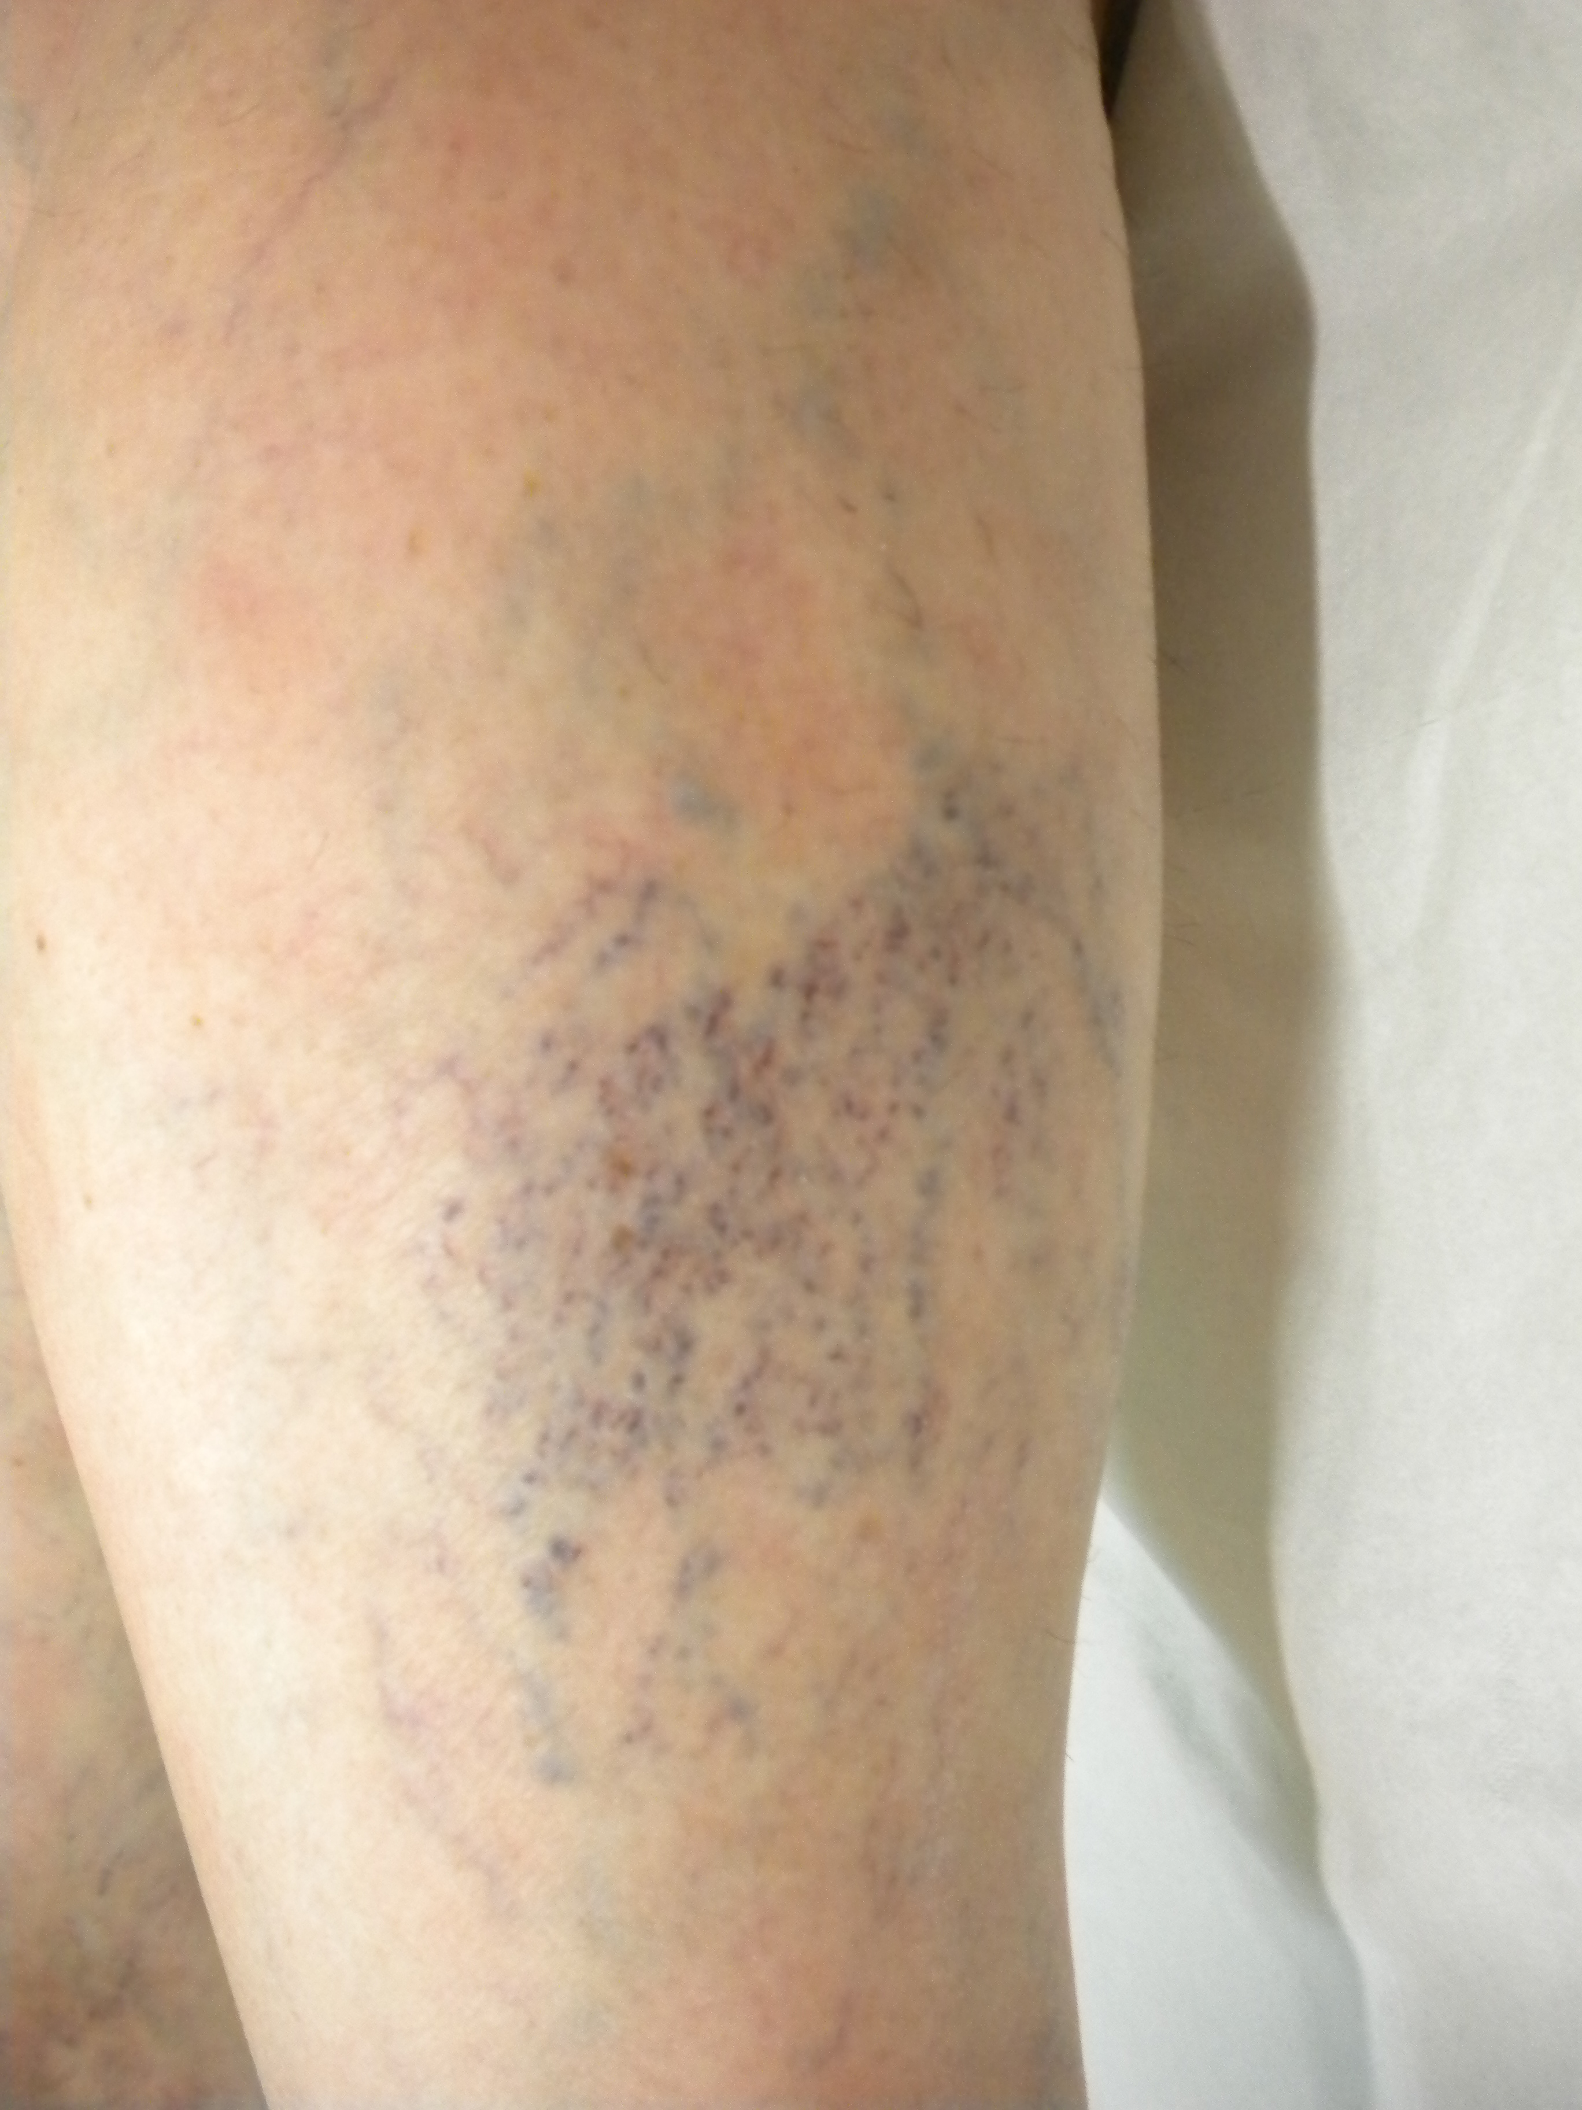
The filling gradient
1) The Telangiectasic hair is fill by a reticular vein
The reticular vein origin by an escape point or by an incompetent saphena
The origin of the flow in the reticular vein is not detectable

Slide 31
2) No filling vein is detectable ( hair up )
Hydrostatic gradient dosen’t change the filling gradient , but change the draining gradient
worsens or does not change

Slide 32
Problemi aperti:
Fisiopatologia delle teleangectasie
Rapporti con le vene reticolari
Fisiopatologia del sottocutaneo
Strategia del trattamento
We have no information about venous skin drainage in cellulite
We have only anatomical and structural data
MR microimaging dimostra la presenza di setti fibrosi a disposizione verticale
Termografia : diagnosi basata sulla disomogenità
Su pubmed la ricerca cellulite telangectasia non da nessun risultato
Problema della definizione del ruolo delle perforanti
Non ci sono lavori di studio dei capillari con l’ECD , ultimi del 1993

