Slide 1
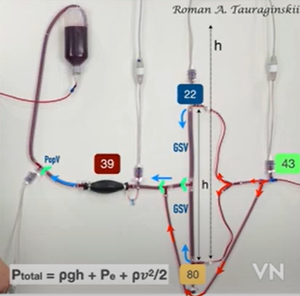
SFJ
Closed shunt

Slide 2
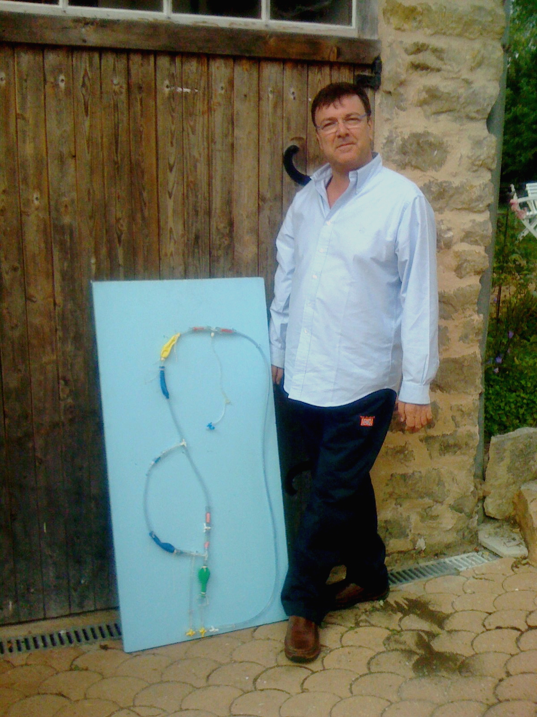

Slide 3
Card. Pump valves
Card. Pump valves:
R. Atr Vol.Press.
R. Atr Vol Press
Cava V: Vol,Press
Cava V: Vol,Press
Card. Pump Seringe
Card. Pump Seringe
Faucet
Faucet
Valve
Valve
Fem. V
Fem. V
Pop. Valves Faucet
Pop. Valves Faucet
GSV Vol,Press
GSV Vol,Press
Calf Pump
Calf Pump
3 Faucets: Res.P var.
3 Faucets: Res.P var.

Slide 4
Card. Pump valves
Card. Pump :valves
R. Atr Vol.Press.
R. Atr Vol Press: Atrium Volume-pressure
Cava V: Vol,Press
Cava V: Vol,Press: Reservoir effect.
Card. Pump . Seringe : hand push-pull heart mimicking
Card. Pump Seringe
Arteries
Arteries
GSV valve faucet : stop, incompetence : mimicking closed shunts and open vicarious shunts
GSV Valve Faucet
Fem. V
Valve: compotent and incompetent
Fem. V
Pop V. Valves Faucet
Pop V. Valves Faucet:. Mimicking. Block, incompetnece Open vicarious Shunts
GSV Vol,Press
GSV Vol,Press: Balloon Volume Pressure variation asseessment
Calf Pump
Calf Pump: Hand Press-release systole-diastole mimicking
3 Faucets: Res.P var.
3 Faucets opening variation: Res.P var. Residual volume-pressure variation in deep veins and/or GSV

Slide 6
