Slide 1
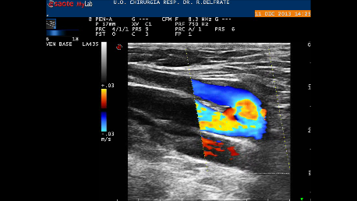
SYSTOLE: No reflux in both duplicated femoral vein channels

Slide 2
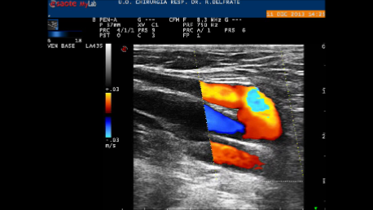
DIASTOLE: Incompetent channel : Reflux
Competent Channel: antegrade flow feeds the reflux together with the above femoral incompetent vein

Slide 3
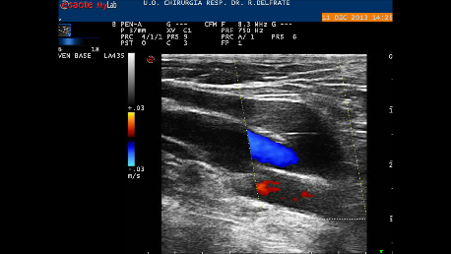
CHIVA: Shunt disconnection at the escape point of the deep closed shunt :
No more Femoral Reflux

Slide 4
SYSTOLE: No reflux
DIASTOLE: Reflux
Shunt disconnection at the escape point: No more Reflux

