Slide 1
VARICOSE VEINS and CVM
UPPER EXTREMITY
Case report
Claude Franceschi, Roerto Delfrate, Massimo Bricchi
Paris, Cremona

Slide 2
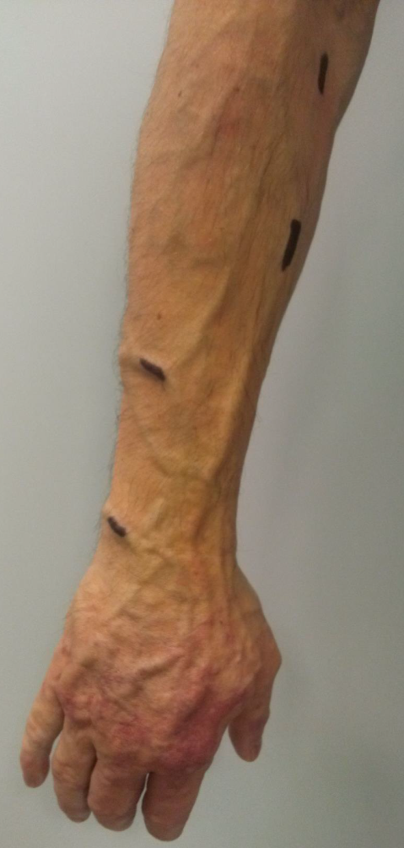
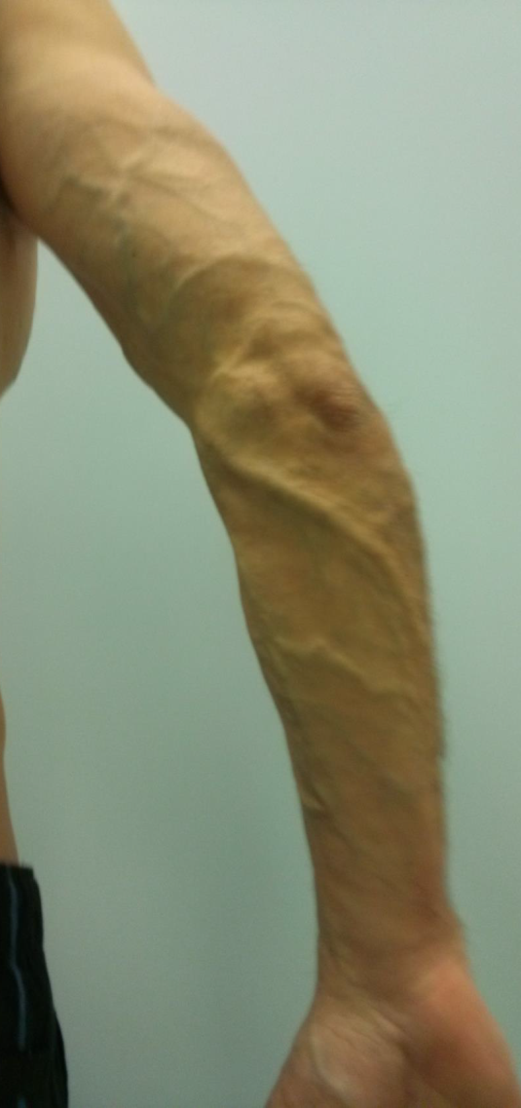
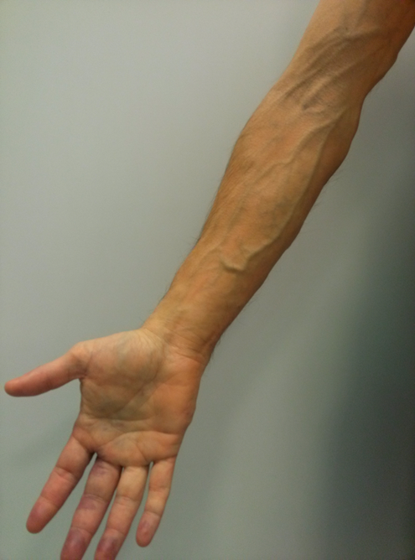
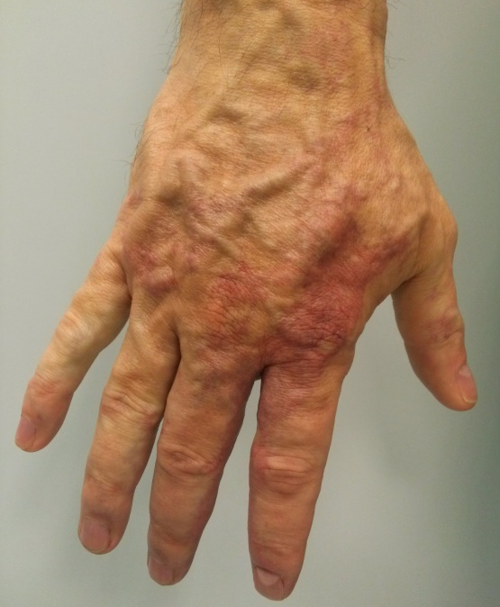
Hand : angioma + extra truncular venous malformation + varicose veins.
Forearm: Varicose veins
+ Heaviness, sweating , ulnar neuralgia

Slide 3
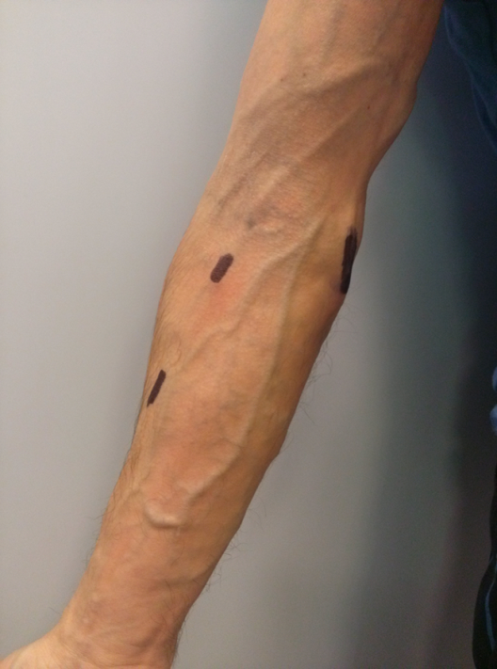
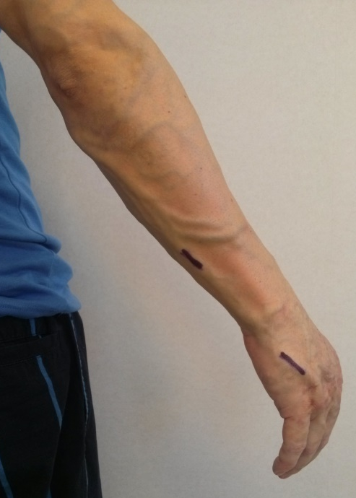
Venous Mapping+ Marking: Disconnection ( 2 cm vein excision under local anesthesia) of refluxing veins flux the competent veins (shunts escape points ). NO phlebectomy no Laser, no Sclerosant.
1st step: 1,2,3,4,5 . 2nd step ( 5 months) 6,7.
1
2
6
3
7
2
1
4
3
5
6
7

Slide 4
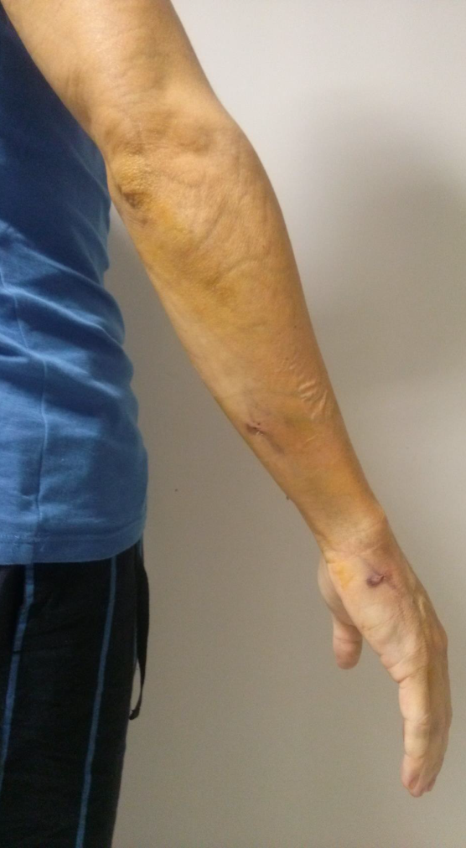
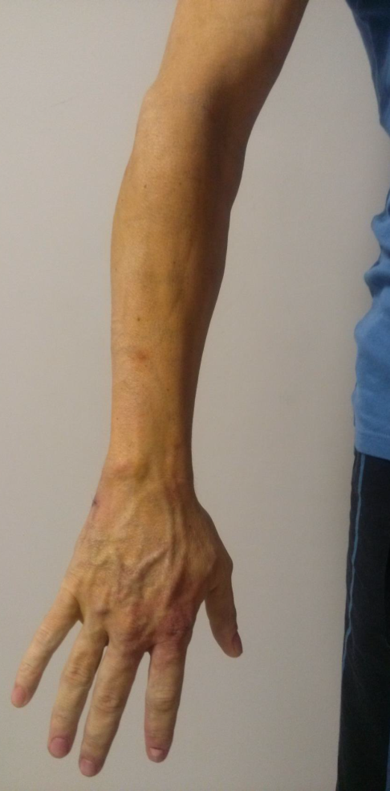
Hand : faded angioma color, collapsed varicose veins Forearm: collapsed Varicose veins
Heaviness, sweating Dramatically relieved
Ulnar neuralgia: Cured

Slide 5
Shunts: closed shunt ( 1 escape point disconnection) and open deviated shunts ( 2,3,4,5,6 escape points disconnection) overload the hand extra-truncular venous malformation and angioma and harms the ulnar nerve. Their disconnection relieves signs and symptoms. Random disconnections and/or ablation could be inefficient or aggravate the disease ( excess of residual pressure and impaired drainage°
Why 2 steps?
Excessive disconnections would hamper the physiological drainage of the hand as well as the angioma would . Thus, progressive disconnection.

