Slide 1
1996 Sackett defined Evidence Based Medecine EBM as "conscious, explicit and judicious use of best available scientific evidence in making decisions about patients: utilisation consciente, explicite et judicieuse des meilleures preuves scientifiques disponibles dans la prise de décisions concernant les patients
Niveau de recommandation selon les évidences (preuves)
Niveau actuel de la preuve : A, B, ou C
Niveau de recommendation:
GRADE 1: Forte recommendation
GRADE 2: Faible recommendation

Slide 2
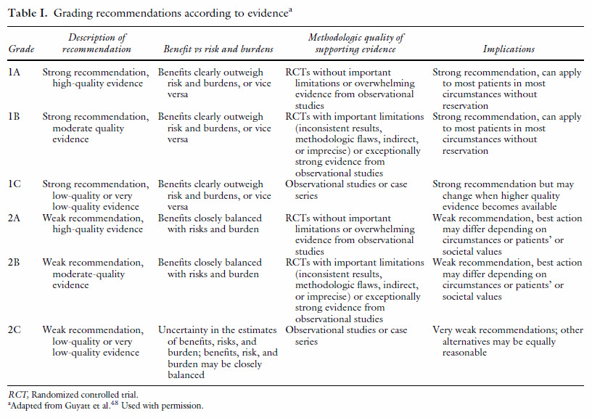

Slide 3
1.- International Committee of Medical Journal Editors (ICMJE):
Uniform Requirements for Manuscripts
CONSORT (Standards of Reporting Trials Consolidate )
Register the study
2.-The Cochrane Library is a collection of six databases that contain different types of high-quality, independent evidence to inform healthcare decision-making, and a seventh database that provides information about groups in The Cochrane Collaboration. The Cochrane Library aims to make the results of well-conducted controlled trials readily available and is a key resource in evidence-based medicine.
Cochrane Criteria: Randomization,Masking of randomization,Blinding
Report results Meta-analyses
The Cochrane Library a collection of databases in medicine and other healthcare specialties provided by the Cochrane Collaboration and other organisations. At its core is the collection of Cochrane Reviews, a database of systematic reviews and meta-analyseswhich summarize and interpret the results of medical research.

Slide 4
Published Meta-analyses on Chronic Venous Disease
1. Murad MH, Coto-Yglesias F, Zumaeta-Garcia M, Elamin MB, Duggirala MK, Erwin PJ, et al. A systematic review and meta-analysis of the
treatments of varicose veins. J Vasc Surg 2011;53(Suppl 2):51S-67S.
2. Hoggan BL, Cameron AL, Maddern GJ. Systematic review of endovenous laser therapy versus surgery for the treatment of saphenous varicose veins.
Ann Vasc Surg 2009;23:277-87.
3. O’Meara S, Cullum NA, Nelson EA. Compression for venous leg ulcers. Cochrane Database Syst Rev 2009:
4. Leopardi D, Hoggan BL, Fitridge RA, Woodruff PW, Maddern GJ. Systematic review of treatments for varicose veins. Ann Vasc Surg
2009;23:264-76.
5. Luebke T, Brunkwall J. Meta-analysis of subfascial endoscopic perforator vein surgery (SEPS) for chronic venous insufficiency. Phlebology
2009;24:8-16.
6. Palfreyman SJ, Michaels JA. A systematic review of compression hosiery for uncomplicated varicose veins. Phlebology 2009;24 (suppl
1):13-33.
7. Luebke T, Brunkwall J. Meta-analysis of transilluminated powered phlebectomy for superficial varicosities. J Cadiovasc Surg 2008;49:
757-64.
8. Luebke T, Brunkwall J. Systematic review and meta-analysis of endovenous radiofrequency obliteration, endovenous laser therapy, and foam
sclerotherapy for primary varicosis. J Cadiovasc Surg 2008;49: 213-33.
9. Luebke T, Gawenda M, Heckenkamp J, Brunkwall J. Meta-analysis of endovenous radiofrequency obliteration of the great saphenous vein in
primary varicosis. J Endovasc Ther 2008;15:213-23.
10. Jia X, Mowatt G, Burr JM, Cassar K, Cook J, Fraser C. Systematic review of foam sclerotherapy for varicose veins. Br J Surg 2007;94:
925-36.
11. Scurr JR, Gilling-Smith GL, Fisher RK. Systematic review of foam sclerotherapy for varicose veins (Br J Surg 2007; 94: 925-936). Br J
Surg 2007;94:1307-8.
12. Bamigboye AA, Smyth R. Interventions for varicose veins and leg oedema in pregnancy. Cochrane Database Syst Rev 2007:CD001066.
13. Tisi PV, Beverley C, Rees A. Injection sclerotherapy for varicose veins. Cochrane Database Syst Rev 2006:CD001732.
14.. Mundy L, Merlin TL, Fitridge RA, Hiller JE. Systematic review of endovenous laser treatment for varicose veins. Br J Surg 2005;92:1189-94.
15. Tenbrook JA Jr, Iafrati MD, O’Donnell TF Jr, Wolf MP, Hoffman SN, Pauker SG, et al. Systematic review of outcomes after surgical management
of venous disease incorporating subfascial endoscopic perforator surgery. J Vasc Surg 2004;39:583-9.
16. Palfreyman SJ, Lochiel R, Michaels JA. A systematic review of compression therapy for venous leg ulcers. Vasc Med 1998;3:301-13.

Slide 5
Published Guidelines on Chronic Venous Disease
1.Peter Gloviczki, MD et all. The care of patients with varicose veins and associated chronic venous diseases: Clinical practice guidelines of the Society for Vascular
Surgery and the American Venous Forum. J Vasc Surg 2011;53:2S-48S.
2. Khilnani NM, Grassi CJ, Kundu S, D’Agostino HR, Khan AA, McGraw JK, et al. Multi-society consensus quality improvement guidelines for the treatment of lowerextremity
superficial venous insufficiency with endovenous thermal ablation from the Society of Interventional Radiology, Cardiovascular Interventional Radiological
Society of Europe, American College of Phlebology and Canadian Interventional Radiology Association. J Vasc Interv Radiol 2010; 21:14-31.
3. Gloviczki P, editor. Handbook of venous disorders: guidelines of the American Venous Forum. 3rd ed. London: Hodder Arnold; 2009.
4. Nicolaides AN, Allegra C, Bergan J, Bradbury A, Cairols M, Carpentier P, et al. Management of chronic venous disorders of the lower limbs: guidelines according to
scientific evidence. Int Angiol 2008;27: 1-59.
5. Robson MC, Cooper DM, Aslam R, Gould LJ, Harding KG, Margolis DJ, et al. Guidelines for the treatment of venous ulcers. Wound Repair Regen 2006;14:649-62.
6. Agus GB, Allegra C, Antignani PL, Arpaia G, Bianchini G, Bonadeo P, et al. Guidelines for the diagnosis and therapy of the vein and lymphatic disorders. Int Angiol
2005;24:107-68.
7. Rabe E, Pannier-Fischer F, Gerlach H, Breu FX, Guggenbichler S, Zabel M, et al. Guidelines for sclerotherapy of varicose veins (ICD 10: I83.0, I83.1, I83.2, and I83.9).
Dermatol Surg 2004;30:687-93.
8. Kurz X, Kahn SR, Abenhaim L, Clement D, Norgren L, Baccaglini U, et al. Chronic venous disorders of the leg: epidemiology, outcomes, diagnosis and management:
summary of an evidence-based report of the VEINES Task Force. Int Angiol 1999;18:83-102.
9. American Academy of Dermatology. Guidelines of care for sclerotherapy treatment of varicose and telangiectaticleg veins. J Am Acad Dermatol 1996;34:523-8.
10. The Alexander House Group. Consensus paper on venous leg ulcer. J Dermatol Surg Oncol 1992;18:592-602.

Slide 6
Guidelines 2011: the reference
Peter Gloviczki, MD et all. The care of patients with varicose veins and associated chronic venous diseases: Clinical practice guidelines of the Society for Vascular Surgery and the American Venous Forum.
Journal of Vascular Surgery 2011;53:2S-48S.
CRITERES
. the AVF reports on the Venous Summit at the 2006 and 2009 Pacific Vascular Symposiums Guidelines 2011 Results
. previously published consensus documents, and guidelines, meta-analyses
. considered the recommendations published in the third edition of the Handbook of Venous Disorders, Guidelines of the American Venous Forum.

Slide 7
Guidelines 2011: the reference
1.Peter Gloviczki, MD et all. The care of patients with varicose veins and associated chronic venous diseases: Clinical practice guidelines of the Society for Vascular Surgery and the American Venous Forum.
Journal of Vascular Surgery 2011;53:2S-48S.
Venous ulcers
1-Ablation of the incompetent superficial veins in addition to compression therapy
GRADE 1A: “we recommend “ (high quality evidence)
Saphenous incompetence.
1-Endovenous thermal ablation
GRADE 1B: “we recommend” (moderate quality evidence)
2-High ligation and inversion stripping of the saphenous vein
3- CHIVA
GRADE 2B: “we suggest”
4-ASVAL
GRADE 2C: “we suggest”

Slide 8
Guidelines 2011: the reference
1.Peter Gloviczki, MD et all. The care of patients with varicose veins and associated chronic venous diseases: Clinical practice guidelines of the Society for Vascular Surgery and the American Venous Forum.
Journal of Vascular Surgery 2011;53:2S-48S.
Venous ulcers
1-Ablation of the incompetent superficial veins in addition to compression therapy
GRADE 1A: “we recommend “ (high quality evidence) OK pour CHIVA
Saphenous incompetence.
3- CHIVA
GRADE 2B: “we suggest”
NE TIENT PAS COMPTE DES RCT CHIVA actuels , sinon Grade A
Ne tient pas compte de la preservation du capital veineux sinon Recommendation 1

Slide 9
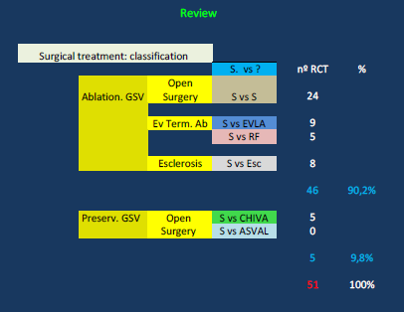
Cochrane Review
Selection des 51 meilleurs articles

Slide 10
Cochrane Review
RCT on Varicose Veins witch 1ari objective is recurrence With 10 years follow-up
Stripping vs. SFL or ESC : Stripping is better than the others
1.Winterborn RJ et all. Causes of varicose vein recurrence: late results of a randomized controlled trialof stripping the long saphenous vein. J Vasc Surg. 2004 Oct;40(4):634-9.
2.Belcaro G et all. Foam-sclerotherapy, surgery, sclerotherapy, and combined treatment for varicoseveins: a 10-year, prospective,randomized, controlled, trial (VEDICO trial). Angiology. 2003 May-Jun;54(3):307-15.
3. Belcaro G, et all. Endovascular sclerotherapy, surgery, and surgery plus sclerotherapy in
superficial venous incompetence: a randomized, 10-year follow-up trial—finalresults.
Angiology. 2000 Jul;51(7):529
Stripping vs CHIVA: CHIIVA is better than Stripping
RCT on Varicose Veins witch 1ari objective is recurrence With 10 years follow-up
1. S. Carandina, et all. Varicose vein stripping vs haemodynamic correction (CHIVA): a long term randomised trial. Eur J Vas Endovasc Surg
2008; 35: 230-7.

Slide 11
Cochrane Review
RCT on Varicose Veins witch 1ari objective is recurrence With 5 years follow-up
Stripping vs. SFL or short Stripping : Stripping is better than SFL and = short Stripping
1. Dwerryhouse S et all. Stripping the long saphenous vein reduces the rate of reoperation for recurrentvaricose veins: five-year results
of a randomized trial. J Vasc Surg. 1999 Apr;29(4):589-92.
2. Holme K et all. Partial or total stripping of the great saphenous vein. 5-year recurrence frequency and 3-year frequency of neural
complications after partial and total stripping of the great saphenous vein. Ugeskr Laeger. 1996 Jan 22;158(4):405-8.
Stripping vs CHIVA: CHIIVA is better than Stripping
1. JO. Parés, et all. Varicose vein surgery. Stripping versus the CHIVA method: a randomized controlled trial.
Annals of Surgery 2010; 251: 624-31.
2. E. Iborra, et all. Comparative study of two surgical techniques in the treatment of varicose veinsof the lower extremities: results afeter five years of
monitoring. Angiología 2006; 58: 459-68.

Slide 12
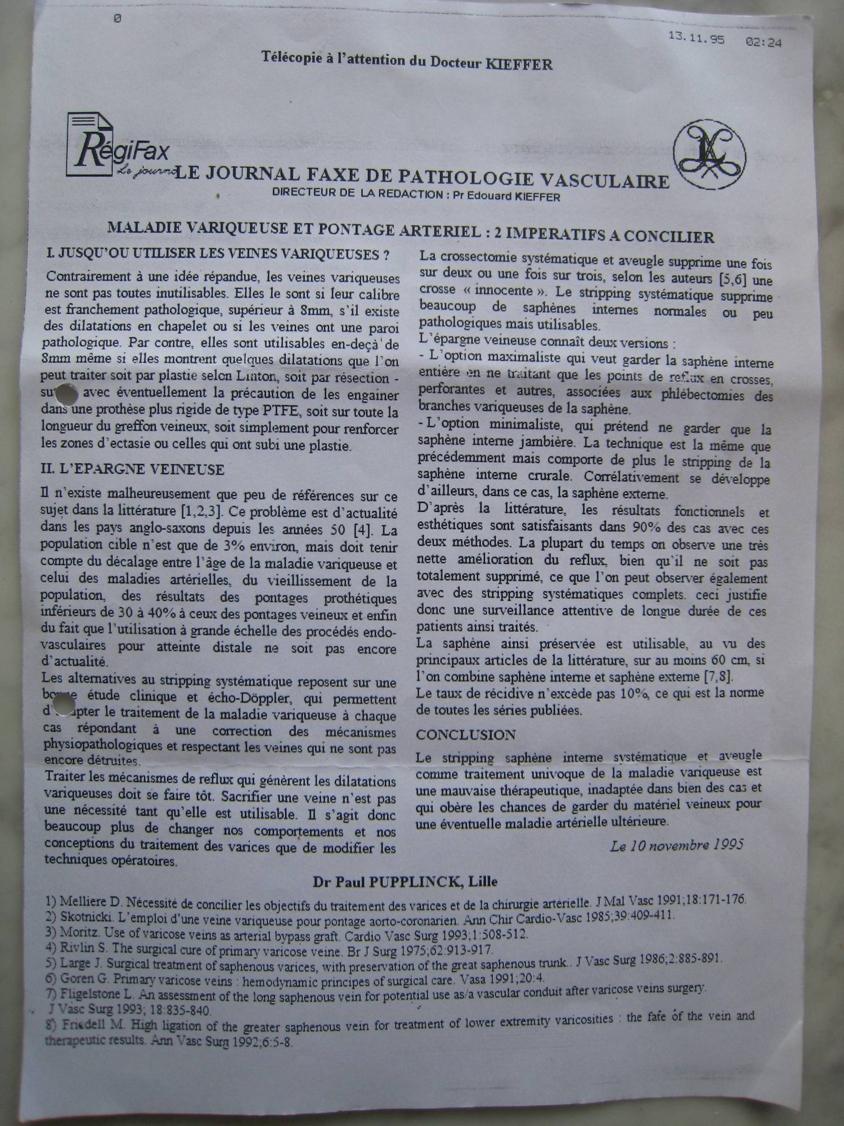

Slide 13
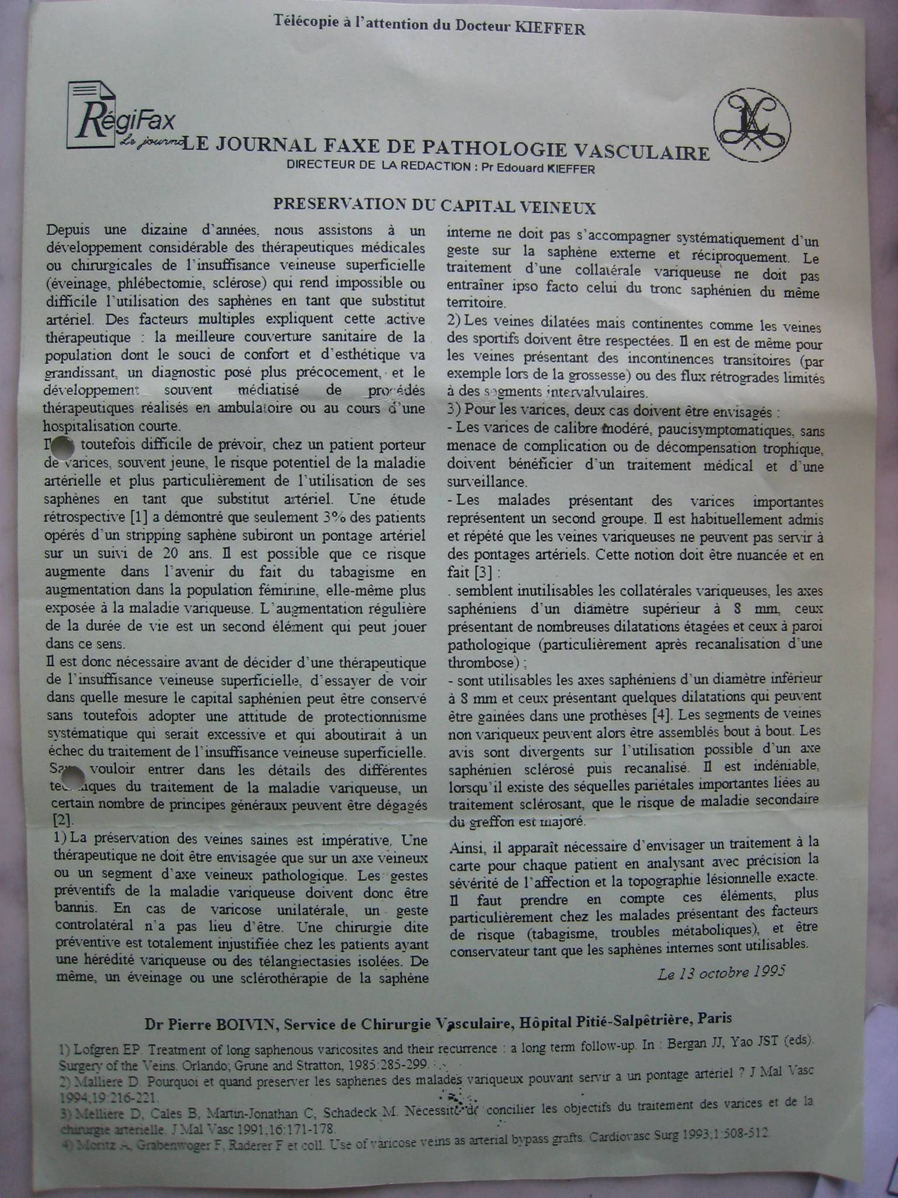

Slide 14
1: J Mal Vasc. 1994;19(3):216-21.
[Why and when to preserve the saphenous veins of varicose patients to serve as an arterial bypass?]
[Mellière D.
Service de Chirurgie Vasculaire, Hôpital Henri-Mondor, Créteil.
The greater saphenous veins (GSV) are the best substitute for arterial in several
locations and are often the only convenient graft. As patients consult for
varicose veins at an increasingly younger age and since surgery for varicose
veins has become quite popular, there is a risk of unneeded destruction of
saphenous veins which will be lacking later. Approximately 80% of the GSV veins
in patients consulting for varcosities are normal, slightly dilated or simply
have one or more minor areas of dilatation. A special Dacron sheath can be used
to maintain these areas of dilatation. The cases presented here demonstrate that
these bypass remain patent and that non-sheated areas do not undergo undue
dilatation. This technique makes it possible to widen the use of GSV in a larger
number of patients with varicose veins. Consequently, it is necessary to verify
the caliber of the trunk of GSV during the echo-Doppler examination before
treating patients with varicose veins. Suitable GSV should be conserved during
initial treatment. Patients should be well informed of the rationale for such
decisions, especially concerning the chronological delay between the occurrence
of venous varicosities and arterial disease.
PMID: 7798809 [PubMed - indexed for MEDLINE]

Slide 15
PMID: 7798809 [PubMed - indexed for MEDLINE]
Related Links
1-Wrapped autologous greater saphenous vein bypass for severe limb ischemia in
patients with varicose veins. Preliminary report. [J Cardiovasc Surg (Torino).
1995] PMID:7790328
2-Residual varicose veins below the knee after varicose vein surgery are not
related to incompetent perforating veins. [J Vasc Surg. 2006] PMID:17098541
3-[Surgical techniques used for the treatment of varicose veins: survey of practice
in France] [J Mal Vasc. 2003] PMID:14978433
[3-Necessity of reconciling the objectives of the treatment of varices and arterial
surgery. Practical consequences] [J Mal Vasc. 1991] PMID:1861112
[J Vasc Surg. 2006] PMID:16950441

Slide 16
1: Eur J Vasc Surg. 1990 Aug;4(4):361-4.
Long saphenous vein saving surgery for varicose veins. A long-term follow-up.
Hammarsten J, Pedersen P, Cederlund CG, Campanello M.
Department of Surgery and Radiology, Hospital of Varberg, Sweden.
The autologous saphenous vein is widely recognised as the graft material of
choice in infra-inguinal arterial reconstructions. This study was undertaken to
evaluate the long-term results of long saphenous vein saving surgery compared
with standard stripping. Forty-two patients with varicose veins were randomly
allocated to treatment, either with standard stripping of the long saphenous vein
or high ligation. In both groups, local varicosities were avulsed and
insufficient perforators ligated, on the basis of physical examination and
phlebography. Follow-up was performed 52 +/- 5 months postoperatively. The
recurrence rate was 12 and 11% in the stripping and the high ligation group
respectively. At follow-up, the venous return time was increased significantly in
both groups (P greater than 0.001). Vein mapping by means of high-resolution,
real-time ultrasound at follow-up showed that 78% of the preserved saphenous
veins were suitable for use as arterial conduits. These results suggest that
removal of the long saphenous vein per se is of no therapeutic value if
insufficient perforators have been ligated. It is possible to perform elective
vein surgery for varicose veins with good results and preserve the long saphenous
vein, which in turn can be used for future arterial reconstruction in most cases.
PMID: 2204548 [PubMed - indexed for MEDLINE]

Slide 17
Saphenous vein sparing surgery: principles, techniques and results. [J Cardiovasc
Surg (Torino). 1998] PMID:9638997
[Does saphenous vein saving surgery have a role in the therapy of primary
varices?] [Rozhl Chir. 2003] PMID:14686260

Slide 18
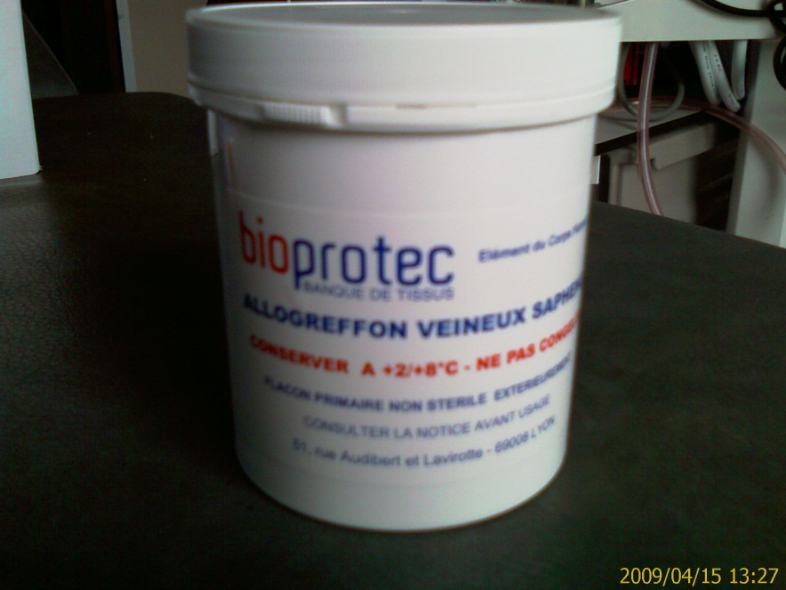
Fondée en 1989, Bioprotec a permis de fédérer sur le territoire français les activités
de recueil de veines saphènes lors du stripping des varices
« Les Allogreffons veineux Bioprotec sont pris en charge en sus des GHS pour
les établissements privés et publics. L e tarif est de 1480.00 euros HT et de 1561.40 euros TTC. »
« Merci de prendre contact avec nous si vous acceptez de participeraux prélèvements
de veines saphènes dont Bioprotec a besoin pour augmenter les stocks d'Allogreffons
dont la demande est constante. »
Pour une information complète :
http://www.bioprotec.fr/bioprotec-v2/site-internet-html/contenu-11.html

Slide 19
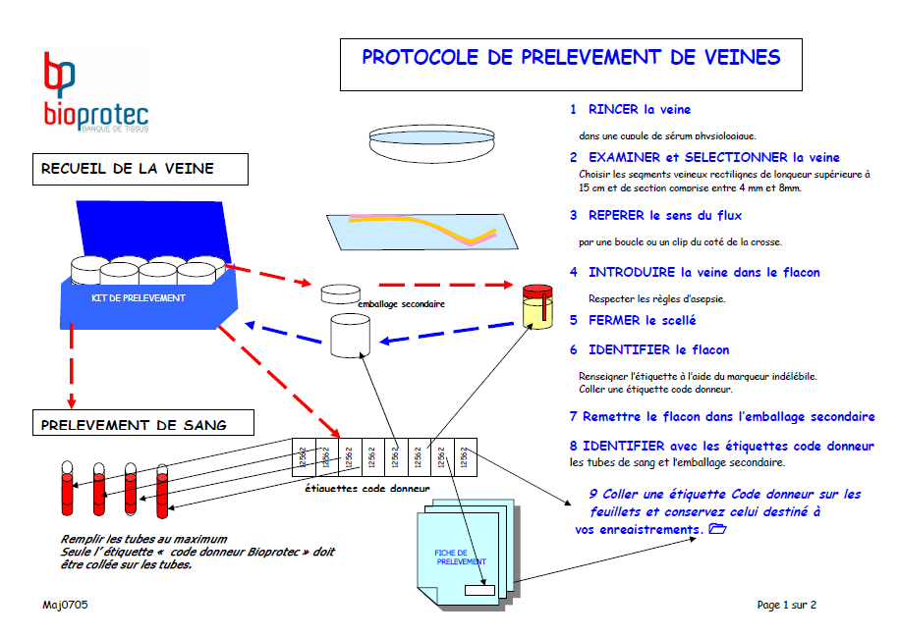

Slide 20
BIBLIOGRAPHIE
Revascularisation des membres inférieurs par allogreffes veineuses conservées à 4°C.
1- Streichenberger R, Barjoud H, Adeleine P, Larese A, Nemoz C, Chatelard P, Nedey C, Sabben
F, Ganichot F, Jurus C. Allogreffes veineuses conservées à 4°C dans les pontages sousinguinaux
:résultats à long terme dans 170 cas. Ann Chir Vasc 2000 ;14 : 553-560
2- La Barbera G, Pumilia G, La Marca G and Martino A. Denatured venous homograft as an
arterial substitute in civilian vascular injuries. Thirty months’ experience. Eur J Vasc Endovasc
Surg, 1998, 467-471
3- Rebane E, Tikko H, Tunder E and al. Venous allografts for infrainguinal vascular bypass.
Cardiovasc Surg 1997 ; 5 :21-25
4- Van Damme H, Creemers E and Limet R. Venous allografts for critical limb ischemia.
Acta chir belg, 1995, 14-20
5- De Leersnijder D, Willocx P, Van Merck E, Vanmaele R.Venous homografts in infrainguinal
procedures : an eight years experience . J Cardiovasc Surg 1992 ; 33 : 633-640
6- Davies A.H, Parums D.V. Storage of donor long saphenous vein.J Cardiovasc Surg 1992, 33 :
92-97.
7- Van Reedt Dortland R.W.H, Van Leeuwen M.S, Steijling J.J.F and al. Long term results with vein
homograft in femoro-distal arterial reconstructions. Eur J Vasc Surg 1991 ; 5 : 557-564.
8- Montessuit M, Brunschweiler Y, Faidutti B. Existe-t-il encore une place pour les homogreffes
veineuses dans le sauvetage artériel des membres inférieurs ?Présenté à la 3éme réunion
commune des sociétés Française et Suisse de Phlébologie, à MONTANA (Suisse), le 24 Janvier
1998.
9- Lacroix B. Homogreffes veineuses : rapport préliminaire à propos d’une série de 39 cas.
Thèse – Université Lyon 1 – 1986.
10- Bietiger M, Dalcher G, Dehaynin G, Pressel P. Notre expérience des greffes veineuses
homologues conservées dans la chirurgie des artériopathies périphériques. Annales
médicales de Nancy. 1979 : 563-566
Page 2 sur 2 0510

Slide 21
Pontages artério-veineux pour hémodialyse par allogreffes veineuses conservées à 4°C.
1- Schneider Marc – Utilisation de greffons saphènes conservés comme voie d’abord à long terme
chez les patients hémodialysés : résultats sur 309 cas – Thèse, université Pierre et Marie Curie
(Paris VI) – 2000 –
2- Schneider M, Barrou B, Cluzel P, Hamani A, Deray G, Bitker M.O, Richard F. Homogreffe
veineuse saphène conservée comme abord vasculaire : expérience de 309 cas. Néphrologie
1999 – Vol.20 – n°5 : 272 .
3- Bosman P.J, Blankestijn P.J, van der Graaf Y, Heintjes R.J, Koomans H.A, and Eikelboom B.C for
the SMASH study group. A comparaison between PTFE and denatured homologous vein grafts
for haemodialysis access : a prospective randomised multicentre trial. Eur J Vasc Endovasc Surg
1998. 16 : 126-132.
4- Berardinelli L and Vegeto A. Lessons from 494 pemanent accesses in 348 haemodialysis
patients older than 65 years of age : 29 years of experience. Nephrol Dial Transplant 1998
13 (Suppl 7) : 73-77.
5- Gecim I.E, Ward R.G, Bakran A, Aikawa A, Sells R.A . A Preliminary Experience with
the Human Homologous Vein Graft for Vascular Access. Vascular Surgery – 1996 - : 395-398
6- Heintjes R.J, Eikelboom B.C, Steijling J.J.F, van Reedt Dortland R.W.H, van der Heidjen F.H.W.M,
Bastini M, van der Graaf Y, Blankestijn P.J and Vos J. The results of denatured homologous vein
grafts as conduits for secondary haemodialysis access surgery. Eur J Vasc Endovasc Surg
1995, 9 : 58-63.
7- Bonnaud P, Lebkiri B, Boudier L et Man NK. Greffons saphènes conservés en hémodialyse. Vingt
ans d’expérience. Néphrologie 1994, 15 : 177-180.
8- R.P. Staal,H.L.F. Brom. Homologous venous grafts for access surgery. In Progress in Access
Surgery 1990 : 22-25. Ed. by J.H.M. Dortoir, P.J.E.H.M. Kistlaar, G.Kootstra. Maastricht.
9- L.Berardinelli, M.Raiteri, R.Canal, G.Tonello, R.Dallatana, A.Vegeto Peculiar complications and
differentiated surgical treatment using various prosthetic materials. Experience with 708 graft
fistuals for hemodialysis. In Progress in Access Surgery 1990 : 29-34. Ed. by J.H.M. Dortoir,
P.J.E.H.M. Kistlaar, G.Kootstra, Maastricht.
10- F.Längle, K. Derfler, B. Watschinger, M. Gnant, P.Götzinger, P.Wamser, W.Manker,
F.Mühlbacher. Homologous saphenous veins as arterio venous fistulas. A comparaison with
different graft materials for vascular access. In Progress in Access Surgery 1990 : 35-40. Ed. by
J.H.M. Dortoir, P.J.E.H.M.Kitslaar, G.Kootstra, Maastricht.
11- Bitker M.O, Rottembourg J, Chatelain C. Voies d’abord vasculaires : utilisation des greffons
biologiques. Annales d’urologie, 1985, 19 : 225-227.
12- Guidoin R, Roy P.E, Bonnaud P, Marois M, King M, Beaudoin G, Paynter R, Hebert J, Gosselin
C. Veines de stripping comme abord vasculaire secondaire pour l’hémodialyse.
Journal des Maladies Vasculaires 1985 10 n°4 : 331-342.

Slide 22
BIBLIOGRAPHIE
Revascularisation des membres inférieurs par allogreffes veineuses conservées à 4°C.
1- Streichenberger R, Barjoud H, Adeleine P, Larese A, Nemoz C, Chatelard P, Nedey C, Sabben
F, Ganichot F, Jurus C. Allogreffes veineuses conservées à 4°C dans les pontages sousinguinaux
:résultats à long terme dans 170 cas. Ann Chir Vasc 2000 ;14 : 553-560
2- La Barbera G, Pumilia G, La Marca G and Martino A. Denatured venous homograft as an
arterial substitute in civilian vascular injuries. Thirty months’ experience. Eur J Vasc Endovasc
Surg, 1998, 467-471
3- Rebane E, Tikko H, Tunder E and al. Venous allografts for infrainguinal vascular bypass.
Cardiovasc Surg 1997 ; 5 :21-25
4- Van Damme H, Creemers E and Limet R. Venous allografts for critical limb ischemia.
Acta chir belg, 1995, 14-20
5- De Leersnijder D, Willocx P, Van Merck E, Vanmaele R.Venous homografts in infrainguinal
procedures : an eight years experience . J Cardiovasc Surg 1992 ; 33 : 633-640
6- Davies A.H, Parums D.V. Storage of donor long saphenous vein.J Cardiovasc Surg 1992, 33 :
92-97.
7- Van Reedt Dortland R.W.H, Van Leeuwen M.S, Steijling J.J.F and al. Long term results with vein
homograft in femoro-distal arterial reconstructions. Eur J Vasc Surg 1991 ; 5 : 557-564.
8- Montessuit M, Brunschweiler Y, Faidutti B. Existe-t-il encore une place pour les homogreffes
veineuses dans le sauvetage artériel des membres inférieurs ?Présenté à la 3éme réunion
commune des sociétés Française et Suisse de Phlébologie, à MONTANA (Suisse), le 24 Janvier
1998.
9- Lacroix B. Homogreffes veineuses : rapport préliminaire à propos d’une série de 39 cas.
Thèse – Université Lyon 1 – 1986.
10- Bietiger M, Dalcher G, Dehaynin G, Pressel P. Notre expérience des greffes veineuses
homologues conservées dans la chirurgie des artériopathies périphériques. Annales
médicales de Nancy. 1979 : 563-566
Page 2 sur 2 0510
Pontages artério-veineux pour hémodialyse par allogreffes veineuses conservées à 4°C.
1- Schneider Marc – Utilisation de greffons saphènes conservés comme voie d’abord à long terme
chez les patients hémodialysés : résultats sur 309 cas – Thèse, université Pierre et Marie Curie
(Paris VI) – 2000 –
2- Schneider M, Barrou B, Cluzel P, Hamani A, Deray G, Bitker M.O, Richard F. Homogreffe
veineuse saphène conservée comme abord vasculaire : expérience de 309 cas. Néphrologie
1999 – Vol.20 – n°5 : 272 .
3- Bosman P.J, Blankestijn P.J, van der Graaf Y, Heintjes R.J, Koomans H.A, and Eikelboom B.C for
the SMASH study group. A comparaison between PTFE and denatured homologous vein grafts
for haemodialysis access : a prospective randomised multicentre trial. Eur J Vasc Endovasc Surg
1998. 16 : 126-132.
4- Berardinelli L and Vegeto A. Lessons from 494 pemanent accesses in 348 haemodialysis
patients older than 65 years of age : 29 years of experience. Nephrol Dial Transplant 1998
13 (Suppl 7) : 73-77.
5- Gecim I.E, Ward R.G, Bakran A, Aikawa A, Sells R.A . A Preliminary Experience with
the Human Homologous Vein Graft for Vascular Access. Vascular Surgery – 1996 - : 395-398
6- Heintjes R.J, Eikelboom B.C, Steijling J.J.F, van Reedt Dortland R.W.H, van der Heidjen F.H.W.M,
Bastini M, van der Graaf Y, Blankestijn P.J and Vos J. The results of denatured homologous vein
grafts as conduits for secondary haemodialysis access surgery. Eur J Vasc Endovasc Surg
1995, 9 : 58-63.
7- Bonnaud P, Lebkiri B, Boudier L et Man NK. Greffons saphènes conservés en hémodialyse. Vingt
ans d’expérience. Néphrologie 1994, 15 : 177-180.
8- R.P. Staal,H.L.F. Brom. Homologous venous grafts for access surgery. In Progress in Access
Surgery 1990 : 22-25. Ed. by J.H.M. Dortoir, P.J.E.H.M. Kistlaar, G.Kootstra. Maastricht.
9- L.Berardinelli, M.Raiteri, R.Canal, G.Tonello, R.Dallatana, A.Vegeto Peculiar complications and
differentiated surgical treatment using various prosthetic materials. Experience with 708 graft
fistuals for hemodialysis. In Progress in Access Surgery 1990 : 29-34. Ed. by J.H.M. Dortoir,
P.J.E.H.M. Kistlaar, G.Kootstra, Maastricht.
10- F.Längle, K. Derfler, B. Watschinger, M. Gnant, P.Götzinger, P.Wamser, W.Manker,
F.Mühlbacher. Homologous saphenous veins as arterio venous fistulas. A comparaison with
different graft materials for vascular access. In Progress in Access Surgery 1990 : 35-40. Ed. by
J.H.M. Dortoir, P.J.E.H.M.Kitslaar, G.Kootstra, Maastricht.
11- Bitker M.O, Rottembourg J, Chatelain C. Voies d’abord vasculaires : utilisation des greffons
biologiques. Annales d’urologie, 1985, 19 : 225-227.
12- Guidoin R, Roy P.E, Bonnaud P, Marois M, King M, Beaudoin G, Paynter R, Hebert J, Gosselin
C. Veines de stripping comme abord vasculaire secondaire pour l’hémodialyse.
Journal des Maladies Vasculaires 1985 10 n°4 : 331-342.
NEJM |
Volume 361:235-244July 16, 2009Number 3Nex
Endoscopic versus Open Vein-Graft Harvesting in Coronary-Artery Bypass Surgery
Renato D. Lopes, M.D., Ph.D., Gail E. Hafley, M.S., Keith B. Allen, M.D., T. Bruce Ferguson, M.D., Eric D. Peterson, M.D., M.P.H., Robert A. Harrington, M.D., Rajendra H. Mehta, M.D., C. Michael Gibson, M.D., Michael J. Mack, M.D., Nicholas T. Kouchoukos, M.D., Robert M. Califf, M.D., and John H. Alexander, M.D., M.H.S.

Slide 23
Problème éthique de la destruction du capital veineux (G.DE WAILLY) Svce Chirurgie Vasculaire CHU Pité Salpétrière Principe de non malfaisance
Matériel de revascularisation
Pontages sous articulaires
Pontages sus articulaire avec mauvais lit d’aval
Pontages en milieu septique
Pontages coronaires multiples
Pontages au membre supérieur
Matériel veineux utilisable
Diamètre < 8 mm
Avec quelques dilatations modérées

Slide 24
Problème éthique de la destruction du capital veineux (G.DE WAILLY) Svce Chirurgie Vasculaire CHU Pité Salpétrière Principe de non malfaisance
Probabilité de la nécessité d’un pontage artériel après chirurgie veineuse : 3% (1)
chirurgies veineuses : 200 000 / an + 6000 000 sclérothérapies
Pontages veineux aorto-coronariens
70% des malades ayant des varices avaient des segments veineux compatible avec réalisation du PAC (2)
Lofgren EP. In Bergan JJ, Yao JST (eds). Surgery of the veins 1985 285-299
Cohn et al, Ann Thor Surg 2006 81(4) 1269-4
6000 pontages / an

Slide 25
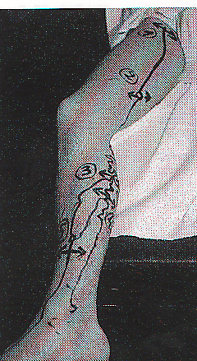
Environnement matériel:
CAPITAL VEINEUX
EchoDoppler
262 cures CHIVA à 6 ans
80% de longueur des troncs saphéniens
préservés et utilisables pour pontage
( Bailly : UPDATE CHIVA Florence 1998)

Slide 26
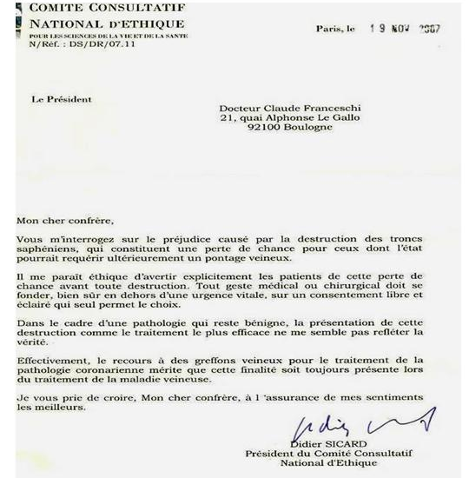

Slide 27
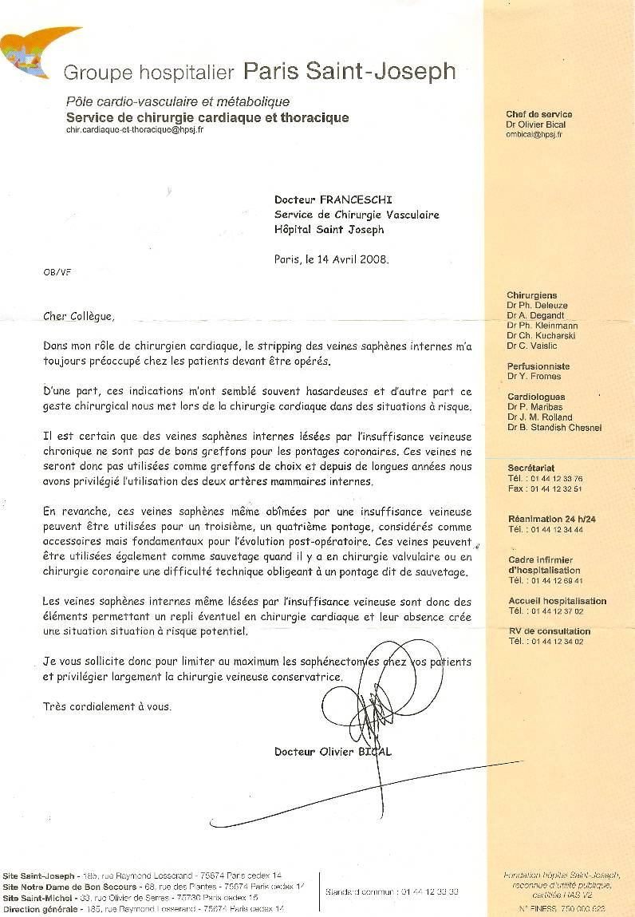

Slide 28
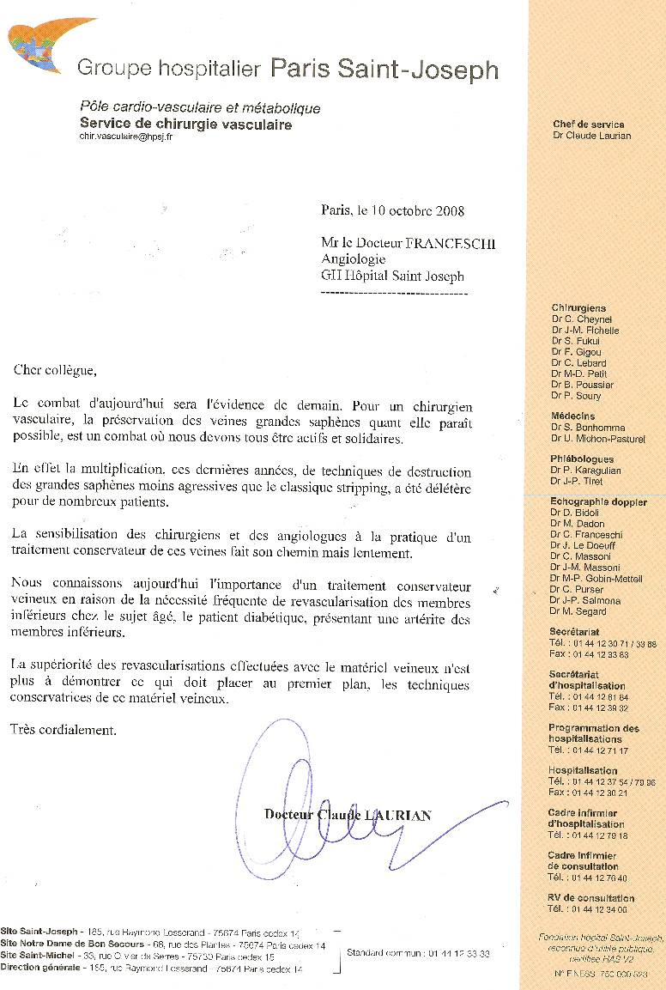

Slide 29
Conclusions
According to COCHRANE Meta-analysis:
CHIVA method is more effective than long-term vein stripping and decreases clinical recurrences of varicose veins and venous ulcers.
With regard to adverse events: the stripping, there are more nerve damage, and subcutaneous hematoma, whereas in the method CHIVA exists superficial venous thrombosis.
In addition:
CHIVA is more effective than long term clinical recurrences endo-venous ablation ( EVA) since stripping is more effective than EVA
Contrary to Stripping and EVA, CHIVA spares the venous capital for further arterial by-pass.
So:
in the next guidelines, the scientific committee will be strong enough argument to agree with the Meta-analysis that has produced the Cochrane and put the CHIVA method in grade 1A recommendation, as it deserves

Slide 30
Conclusions
Selon la Meta-analyse COCHRANE :
CHIVA est plus efficace a long terme que le Stripping , diminue les récidives des varices et des ulcères.
Complications: le stripping entraine plus de dommages nerveux et d’hématomes bien que CHIVA puisse eptre responsables de thromboses veineuses superficeielles.
De plus:
CHIVA est supérieur aux procédures endo-veineuses puisque le stripping est lui même supérieur à celles-là.
Contrairement au stripping et aux procédures endo-veineuses CHIVA preserve le capital veineux en vue d’éventuel pontage artériel.
Aussi:
Aussi, pour les prochaines recommadations , les comités scientifiques devront porter CHIVA au GRADE 1A.

Slide 31
L'information et le consentement aux soins du patient
Maître Bruno LORIT - Avocat à la Cour de Paris En matière de risques, vous devez informer le patient sur : • les risques fréquents ou graves normalement prévisibles de l’acte • les conséquences prévisibles en cas de refus • les risques nouveaux identifiés après la réalisation de l’acte • les risques graves même s’ils sont exceptionnels. vous devez également décrire les différents traitements envisageables et leurs intérêts respectifs. L’omission de cette information constitue donc une faute sanctionnée par les juridictions civiles, pénales, administratives et disciplinaires

