Slide 1
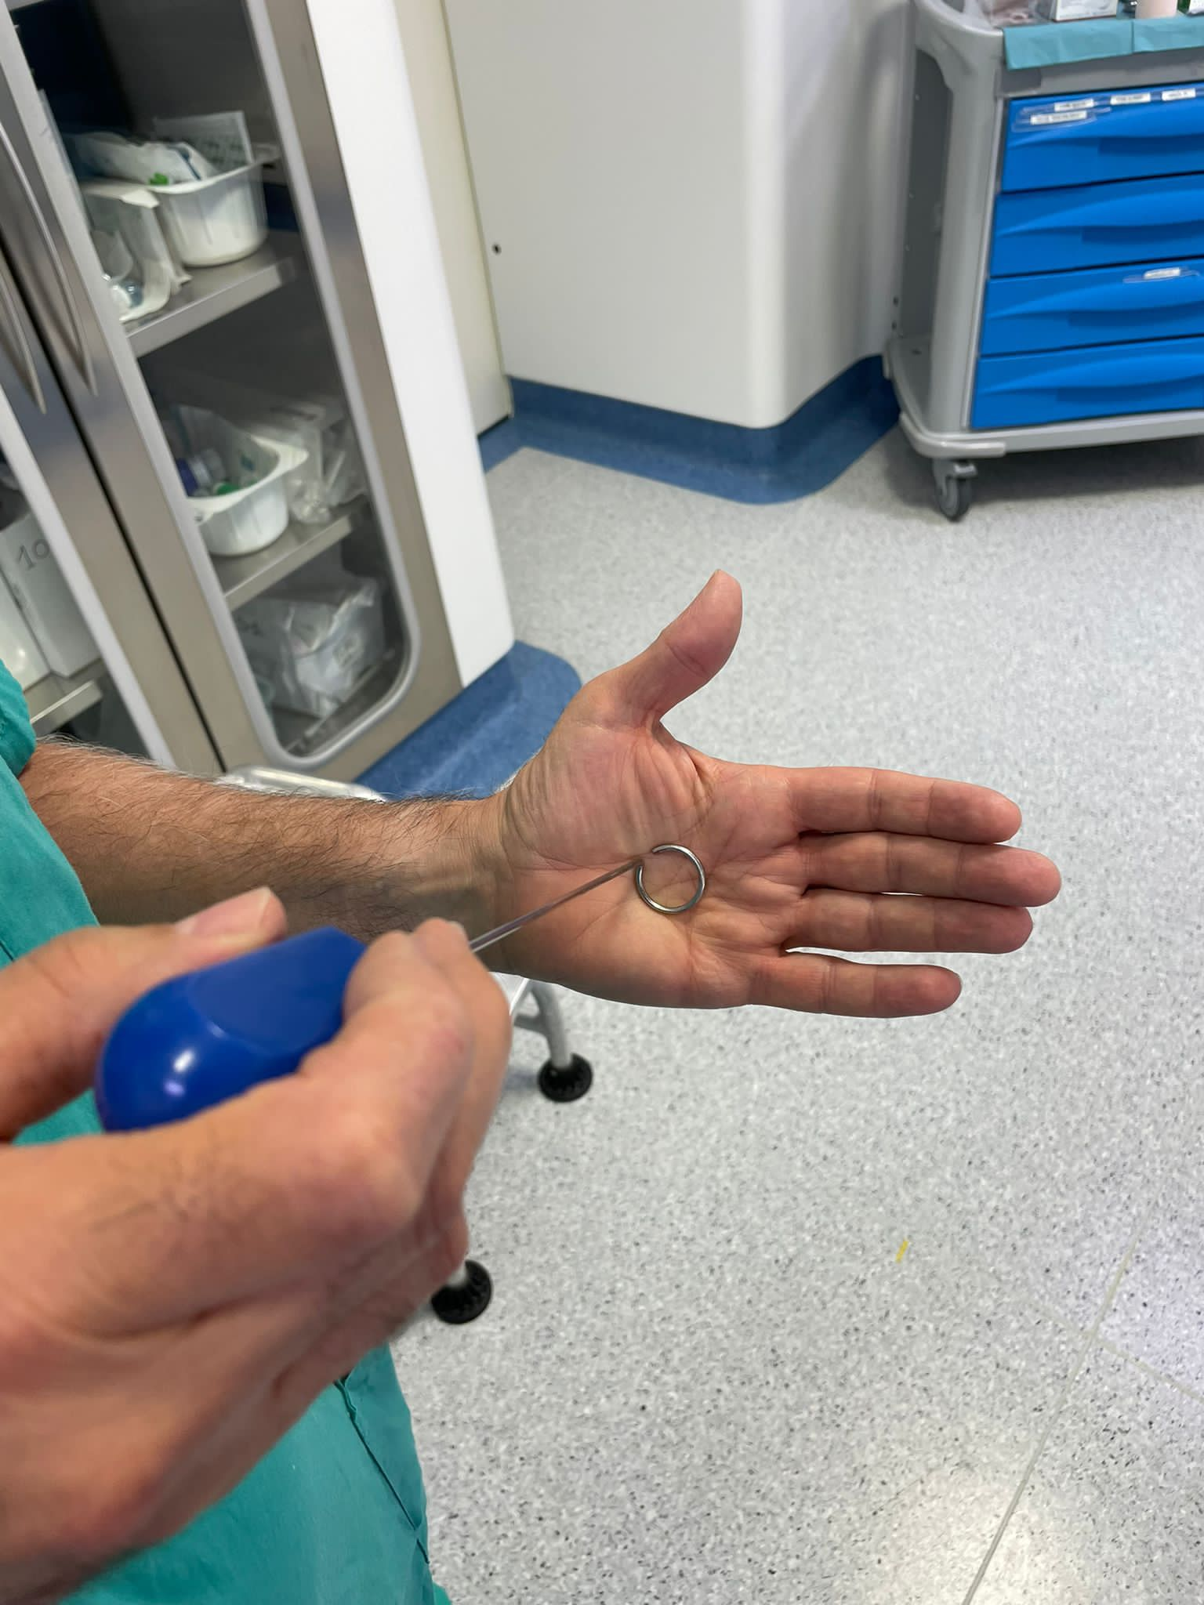
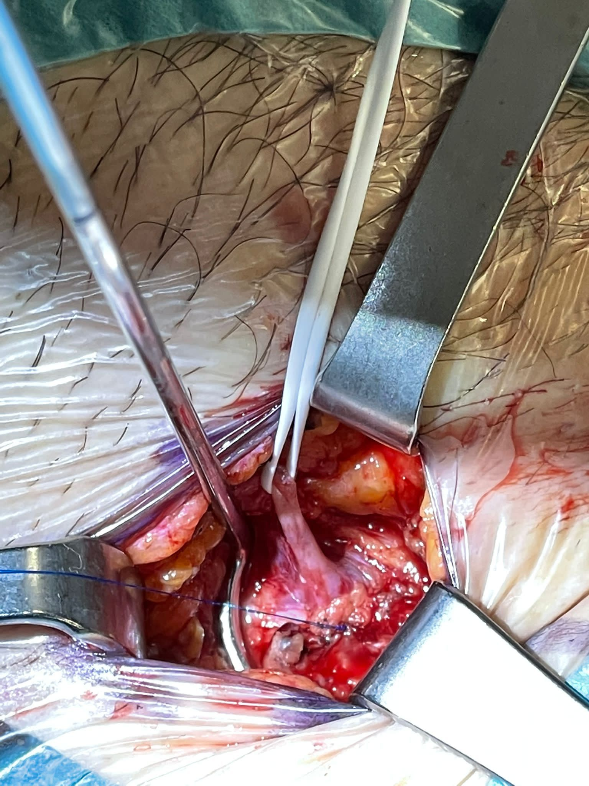
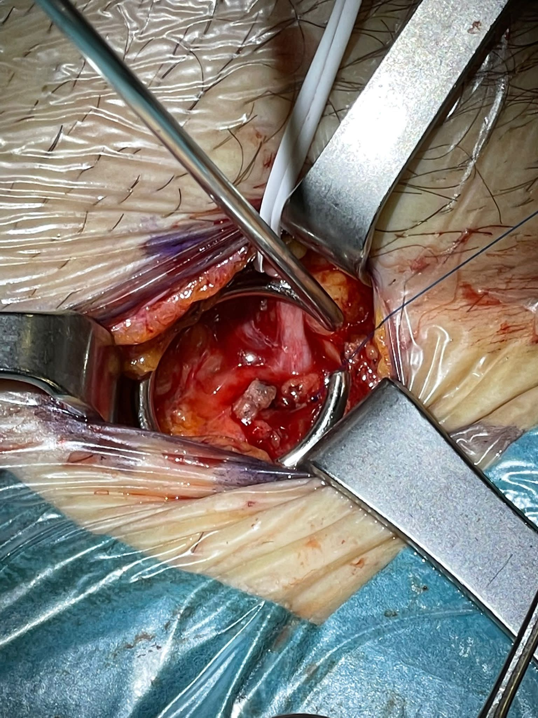
About hemostator:
Redoo surgery for groin recurrence with systolic valsalva refux through the terminal valve. Previous anterior saphena disconnection. Bleeding from stump injury . Reverse Trendelemburg position and 6 zero polipropilene stich thanks to Hemostator hemostasis

Slide 2
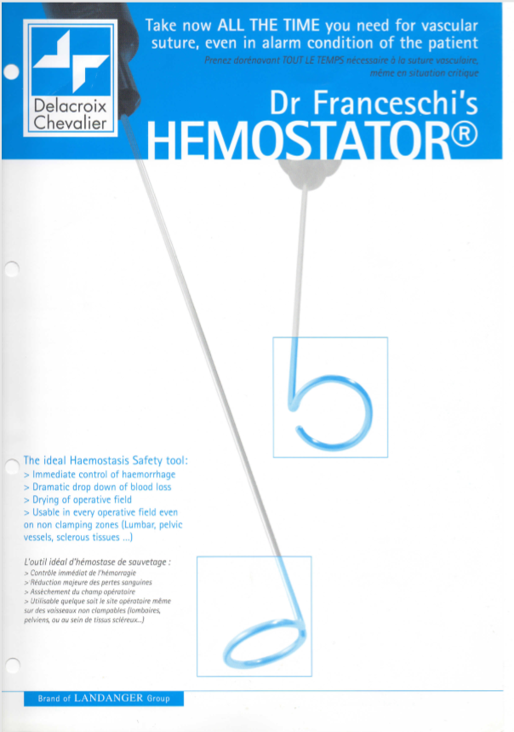
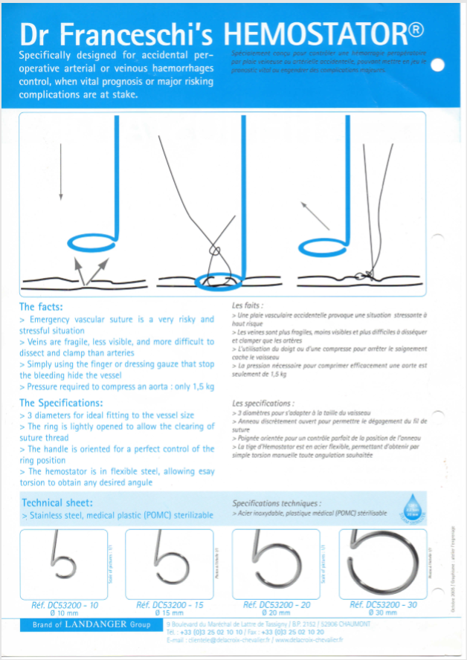

Slide 3
Patent free. Easy to copy.

